Slide 1
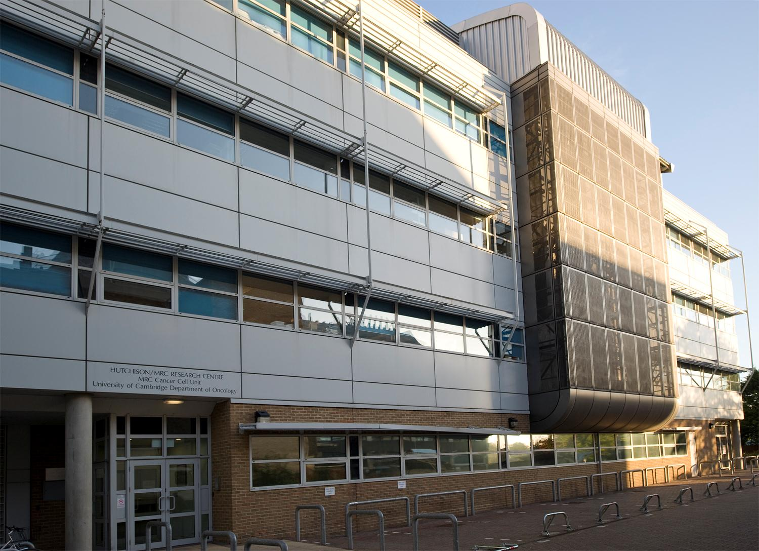


Cancer metabolism,
a hallmark of cancer
Christian Frezza
MRC Cancer Unit

Slide 2
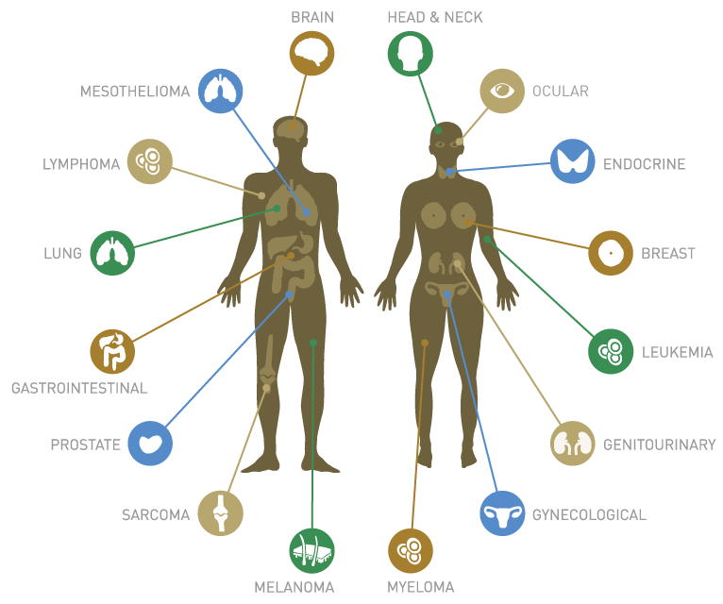
What is cancer?

Slide 3
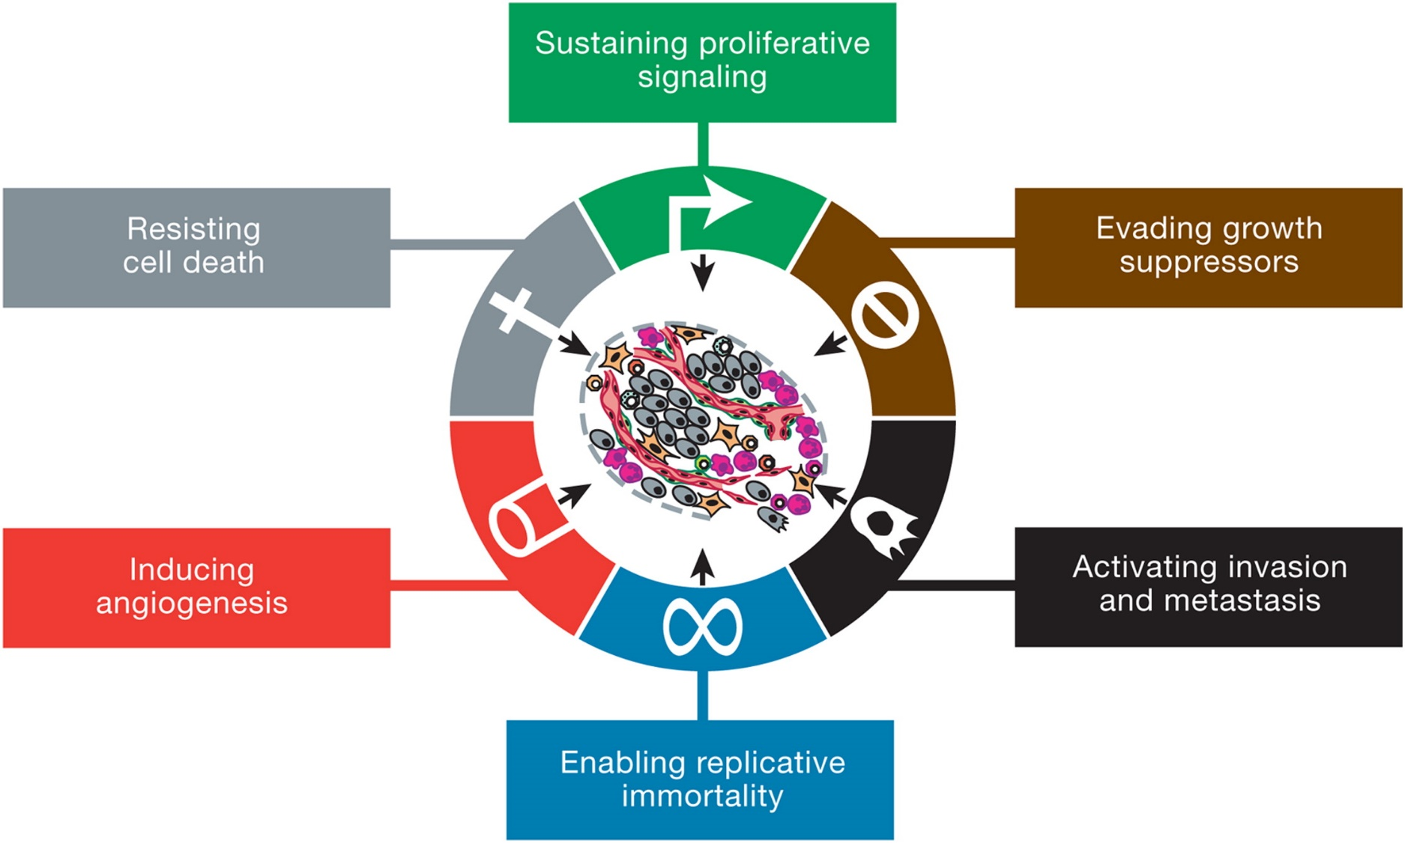
What is cancer?
Douglas Hanahan, Robert A. Weinberg; The Hallmarks of Cancer
Cell, Volume 100, Issue 1, 7 January 2000, Pages 57–70

Slide 4
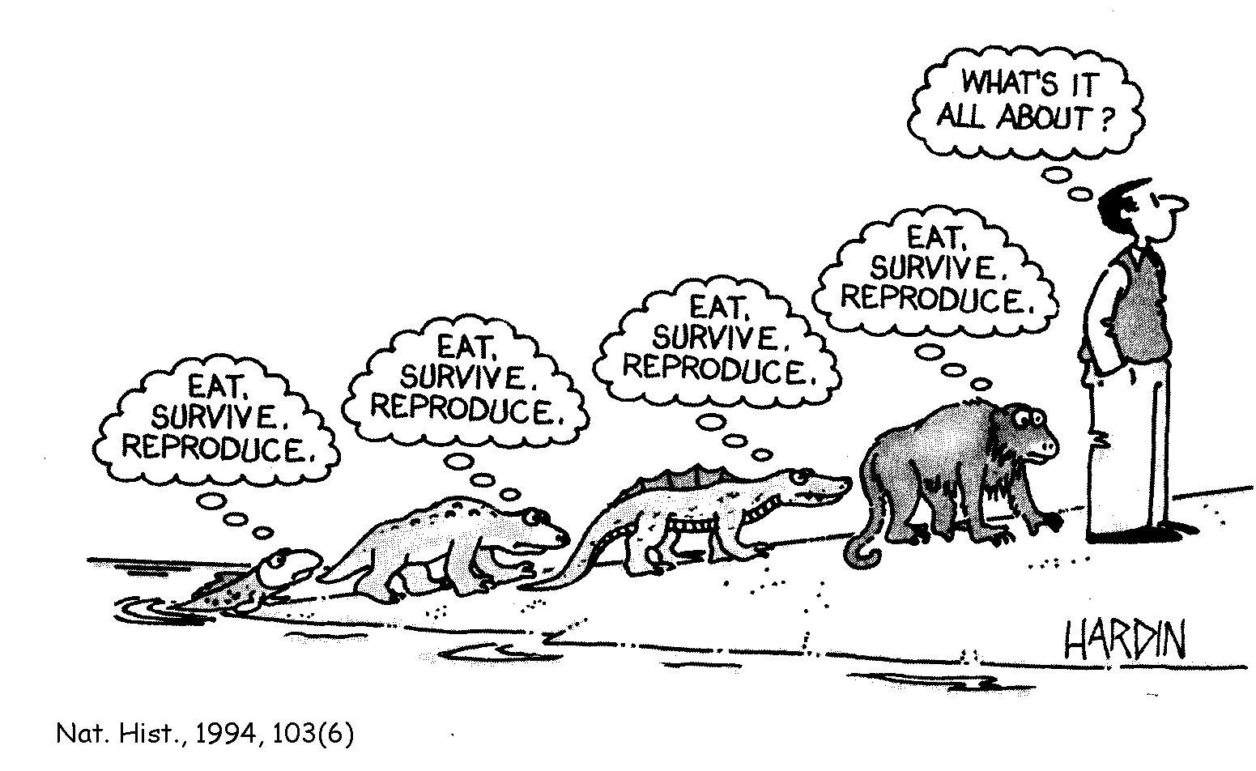
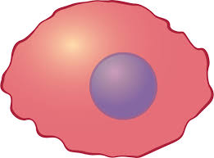
Cancer cells need energy to proliferate
EAT, SURVIVE, REPRODUCE

Slide 5
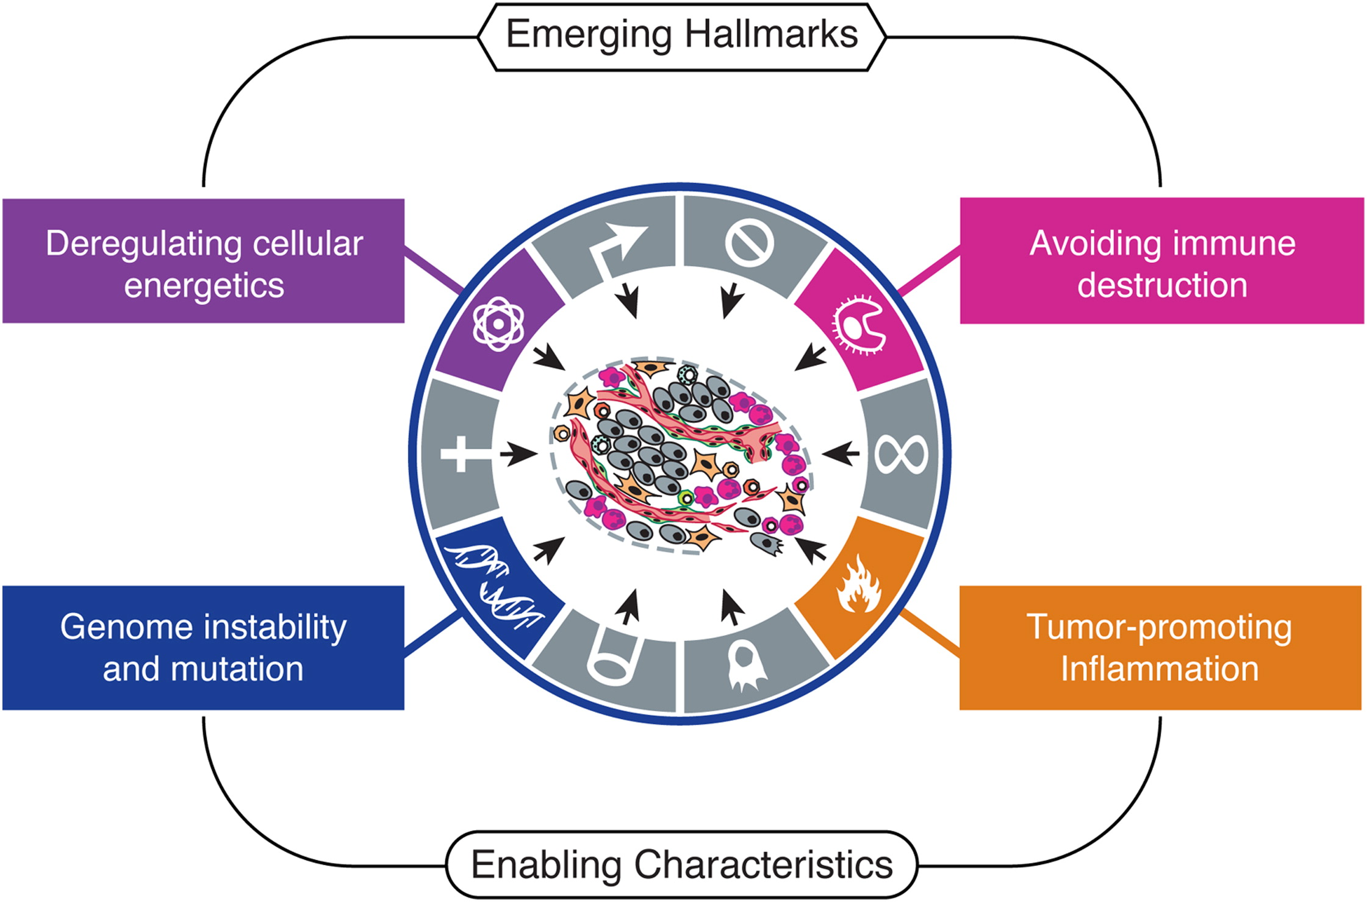
Dysregulated metabolism is a hallmark of cancer
Douglas Hanahan, Robert A. Weinberg; Hallmarks of Cancer: next generation
Cell, Volume 144, Issue 5, p646–674, 4 March 2011

Slide 6
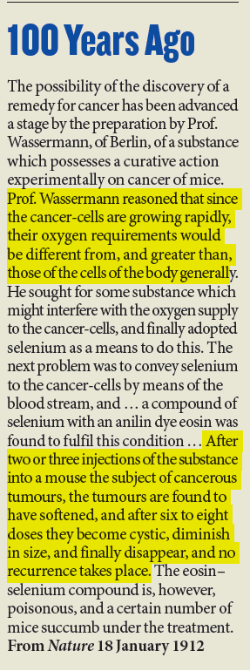
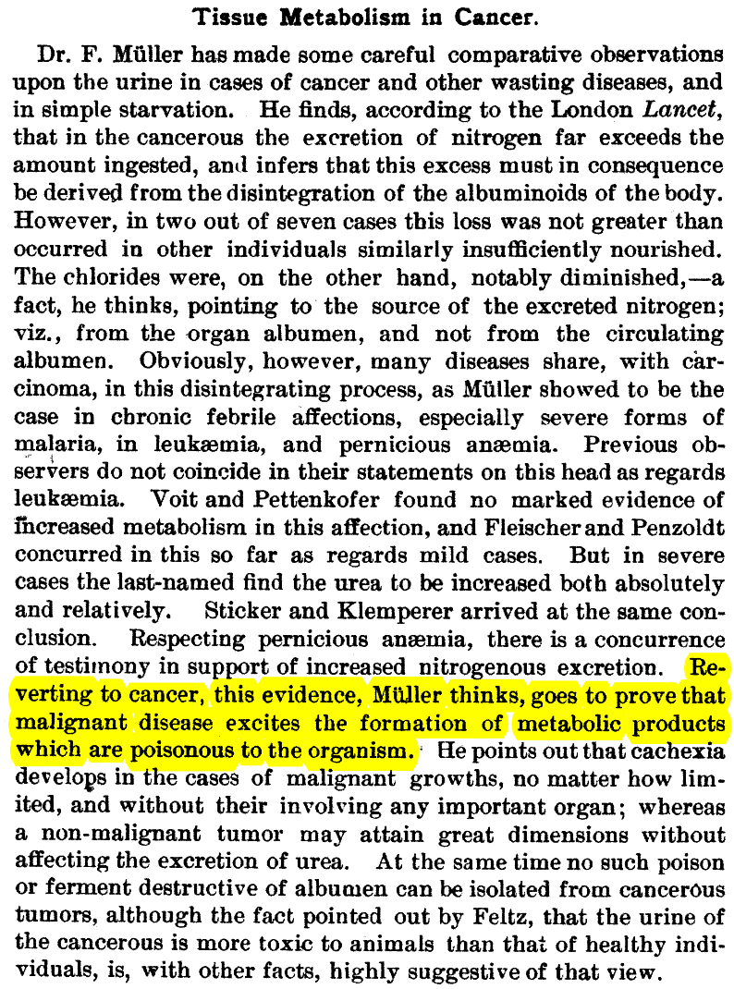
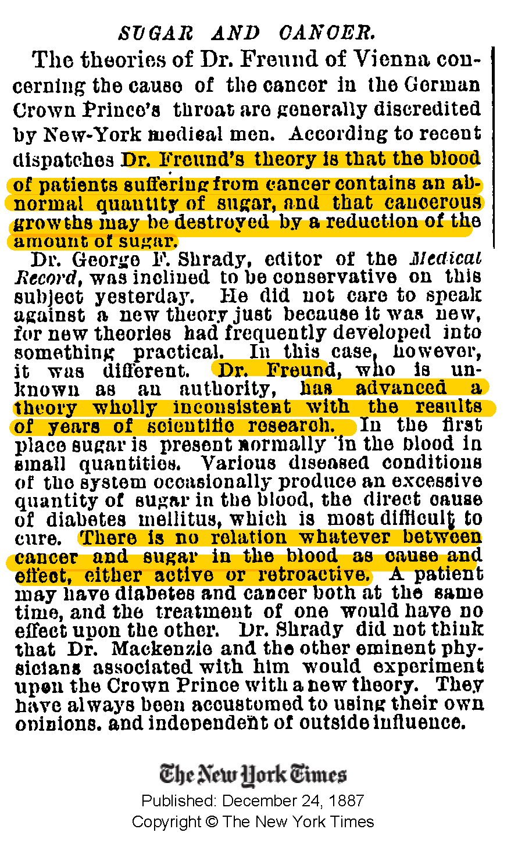
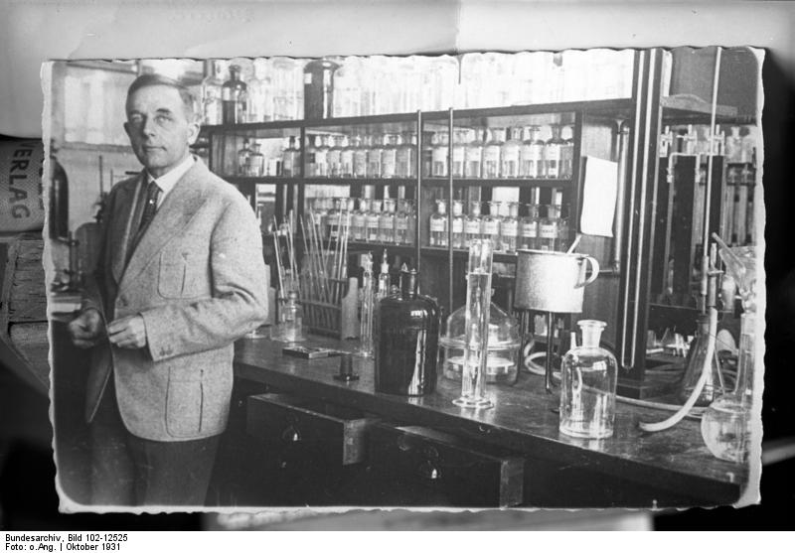
Cancer and metabolism: when it all started
Muller observed aberrant metabolism in urine of cancer patients
Otto Warburg
Freund proposed that blood cancercells can be killed by reducing glucose
Warburg observed the increased glycolysis in cancer cell
1887
1890
1924
1912
Wassermann hypothesised a role of deregulated respiration in cancer cell

Slide 7
The timeline of cancer research
Kovacevic observed increased glutaminolysis in cancer cell
cMyc was discovered
Warburg observed the increased glycolysis in cancer cell
Warburg published
“On the origin of cancer cell”
p53 was identified
1924
1956
1972
1979
1977
Biochemistry era
Genomic era
I was born
debate between Weinhouse and Warburg on mitochondria and cancer

Slide 8
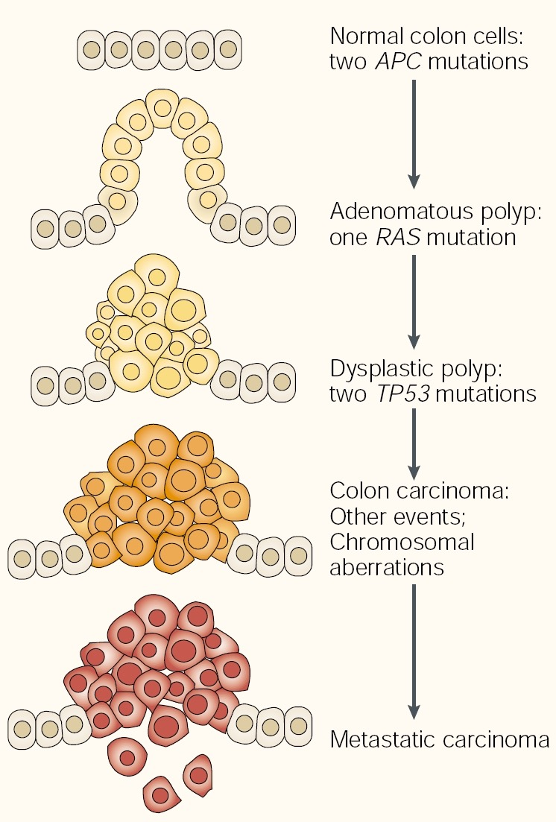
Cancer: a genetic disease
Mutated genes
Transformation

Slide 9
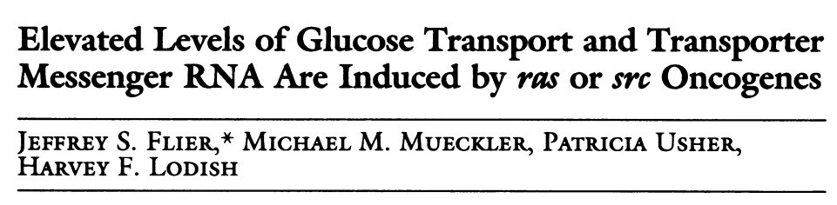
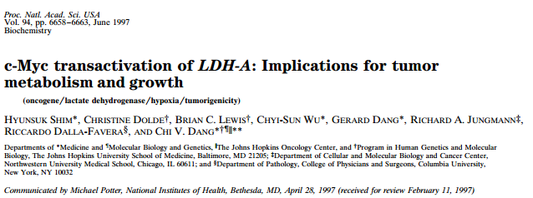
The timeline of cancer research
Src/Ras regulate glycolysis
Mina Bissell
confirmed glucose consumption in virus-transformed cells
c-Myc regulates glycolysis
c-Myc was discovered
Warburg observed the increased glycolysis in cancer cell
Warburg published “On the origin of cancer cell”
p53 was identified
1924
1956
1972
1979
1987
1997
1977
Biochemistry era
Genomic era
I was born
debate between Weinhouse and Warburg on mitochondria and cancer

Slide 10
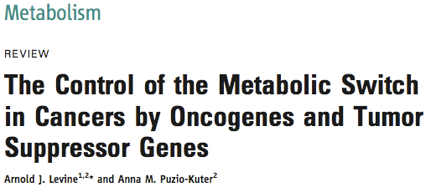
Cancer and Metabolism come together
Mutated genes
Metabolism
Transformation

Slide 11
The timeline of cancer research
Kovacevic observed increased glutaminolysis in cancer cell
cMyc regulates glycolysis
cMyc was discovered
Warburg observed the increased glycolysis in cancer cell
Warburg published “On the origin of cancer cell”
p53 was identified
1924
1956
1972
1979
1997
1977
2000
Biochemistry era
Genomic era
I was born
mutations in mitochondrial proteins SDH and FH are cause of cancer
Debate between Weinhouse and Warburg on mitochondria and cancer

Slide 12
The timeline of cancer research
Kovacevic observed increased glutaminolysis in cancer cell
cMyc regulates glycolysis
p53 regulates cell metabolism via TIGAR, PGM, Sco2
cMyc was discovered
PGHDH is amplified in breast cancer
Warburg observed the increased glycolysis in cancer cell
Warburg published “On the origin of cancer cell”
p53 was identified
1924
1956
1972
1979
1997
2006
2012
1977
2000
2005
2008
2010
2013
2016
Biochemistry era
Genomic era
Metabolomics era
mutations in IDH are found in glioblastoma
I was born
mutations in mitochondrial proteins SDH and FH are cause of cancer
2HG is sufficient to induce leukemogenesis
Debate between Weinhouse and Warburg on mitochondria and cancer
2HG is produced by mutant IDHs and inhibits DNA and histone demethylation
accumulation of succinate in SDH mutants stabilizes HIF
Fumarate induces EMT

Slide 13
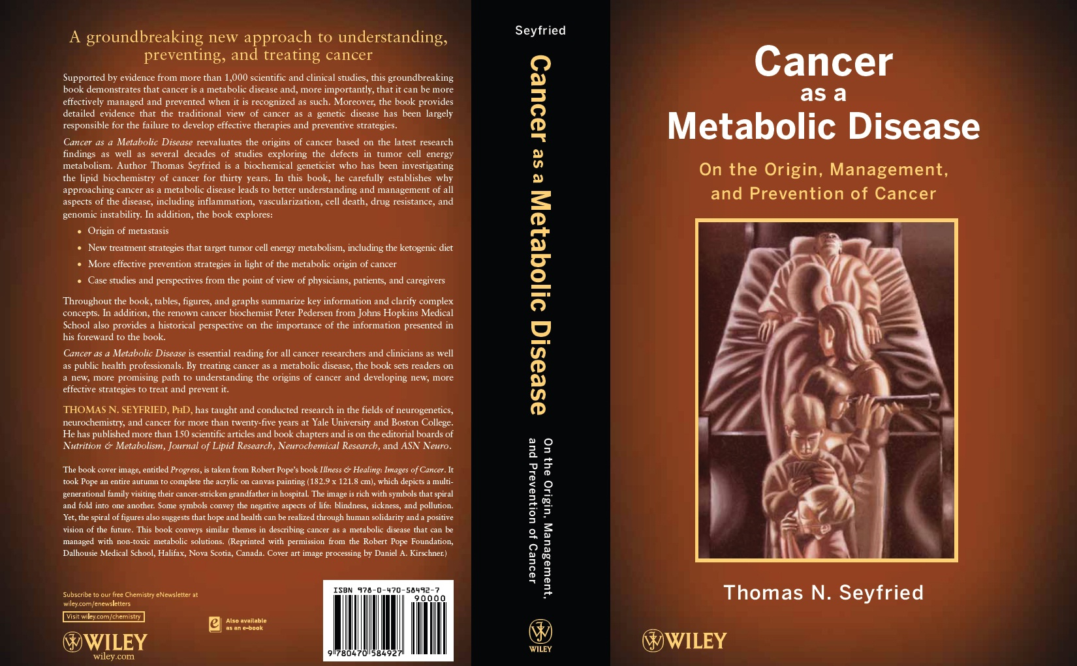
Cancer: a metabolic disease?

Slide 14
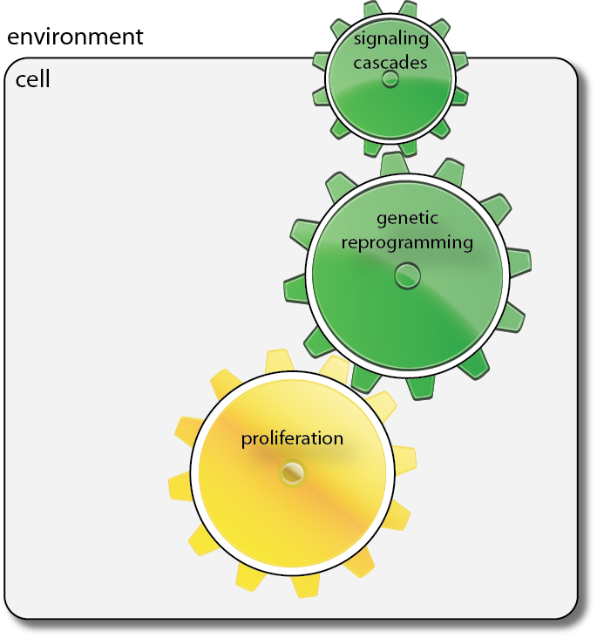
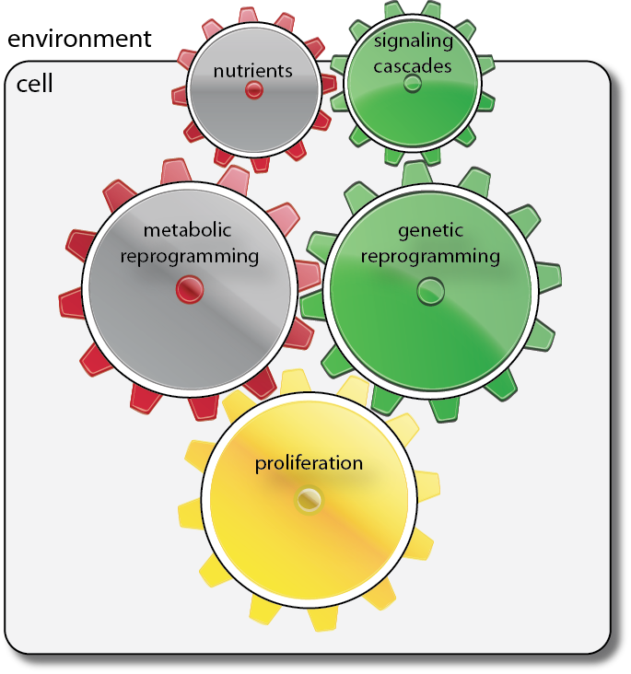
A system view of cancer

Slide 15
Cancer metabolism
An historical perspective on

Slide 16
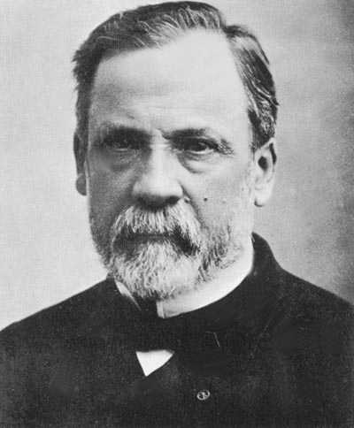
Metabolism in the 19th century
glucose
Pasteur effect
fermentation
lactate
pyruvate
respiration
CO₂
21%
Oxygen concentration
0 %

Slide 17
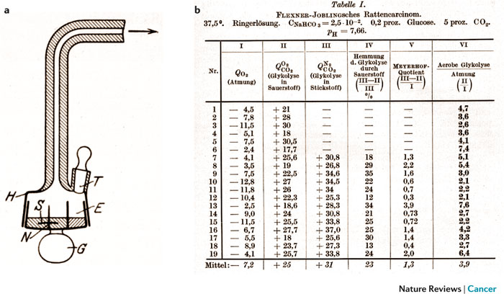
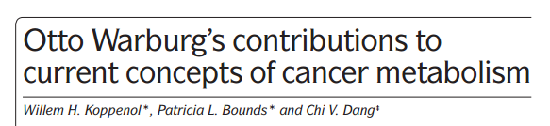
Warburg experiments

Slide 18
Aerobic glycolysis in cancer cells
Normal cell
Cancer cell
glucose
glucose
fermentation
fermentation
lactate
pyruvate
lactate
pyruvate
respiration
CO₂
CO₂

Slide 19
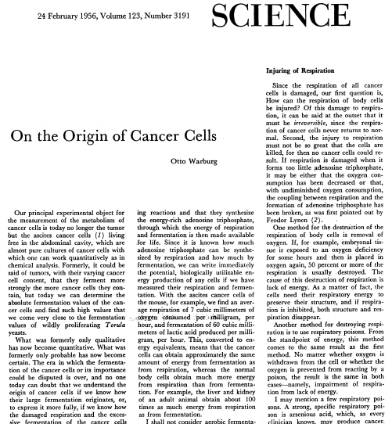
The Warburg hypothesis
The prime cause of cancer is the replacement of the respiration of oxygen…by a fermentation of sugar…”
Injury of respiration
Aerobic glycolysis
De-differentiation
Normal cell
Phase I
Phase II
Phase III
Cancer cell

Slide 20
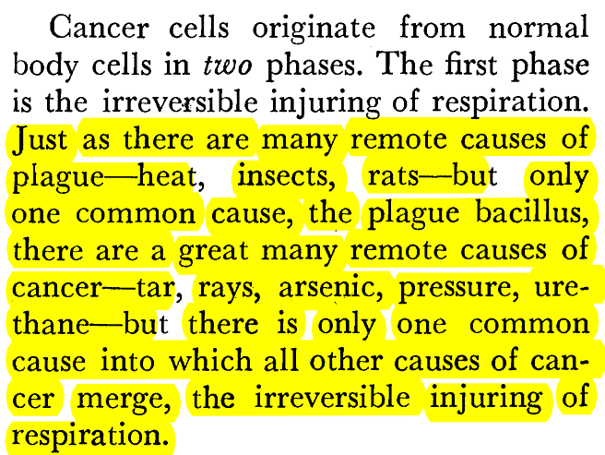
Dissecting the Warburg hypothesis
Injury of respiration
Aerobic glycolysis
De-differentiation
Phase I
Phase II
Phase III

Slide 21
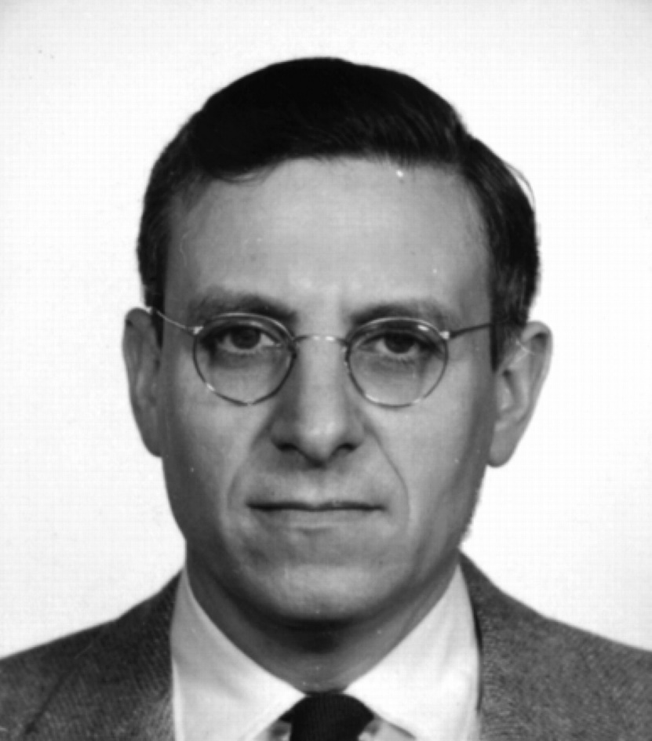
Is respiration in cancer cells injured?
”…there is no evidence…that the respiration in cancer cell is either quantitatively lowered or fails to lower glycolysis…” Weinhouse, Z. Krebsforsh, 1976
Sidney Weinhouse

Slide 22
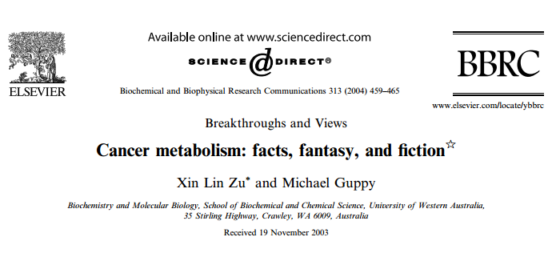
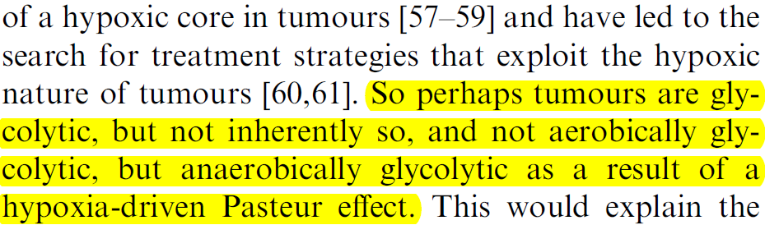
Is hypoxia the cause of mitochondrial dysfunction?
…all Warburg’s experiment were performed using well oxygenated tissues

Slide 23
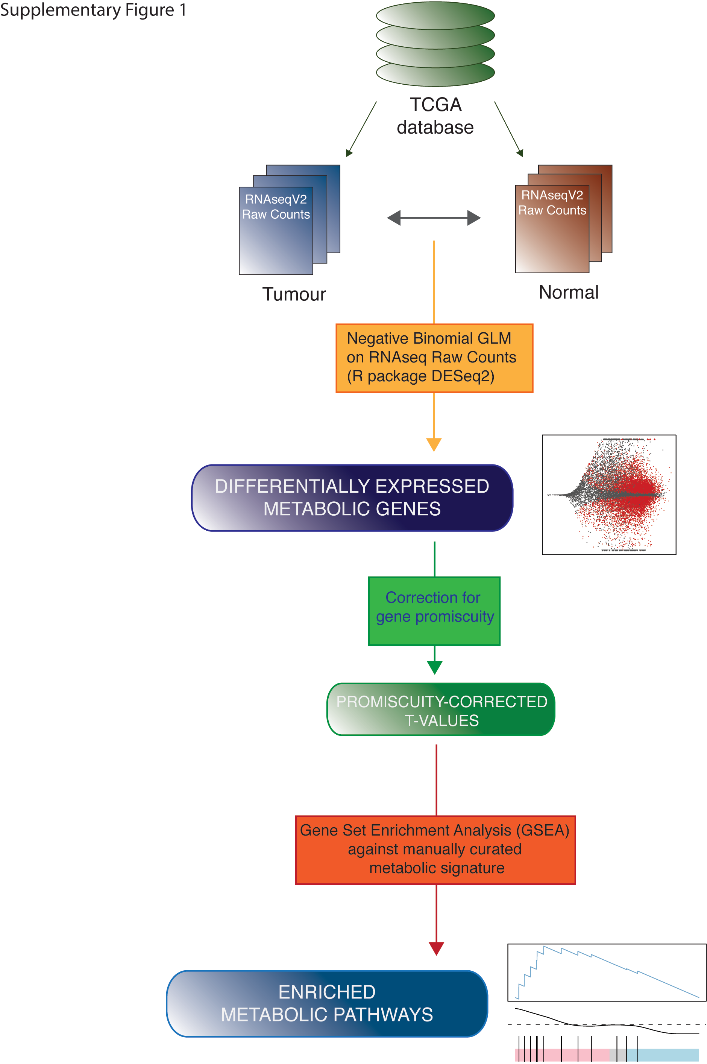
Metabolic landscape of cancer
The Cancer Genome Atlas
22 tumour types
>8000 patients

Slide 24
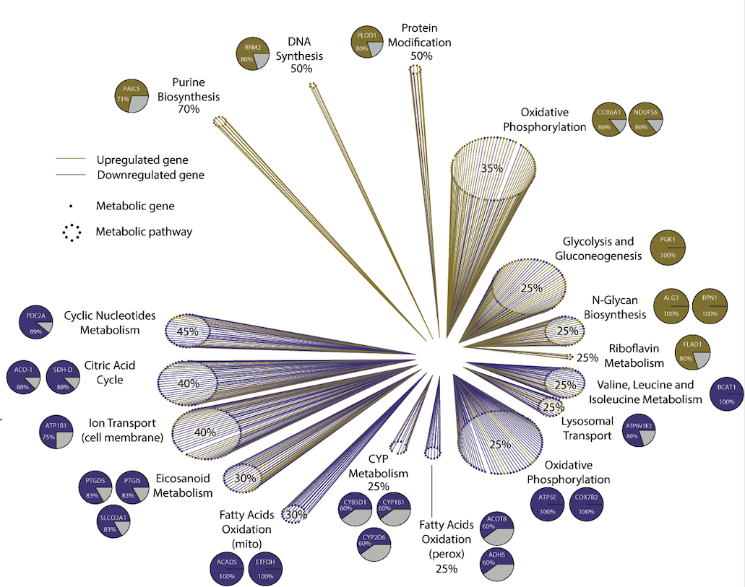
The metabolic landscape of cancer

Slide 25
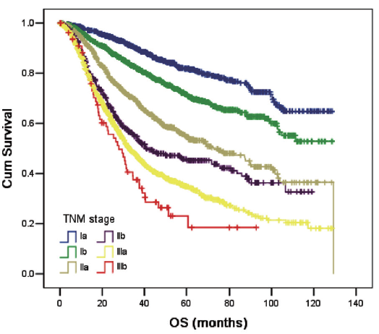
Metabolism and patient outcome
Low Survival
High Survival
Gene Set
Enrichment Analysis
Metabolic Pathways
linked to
patient survival

Slide 26
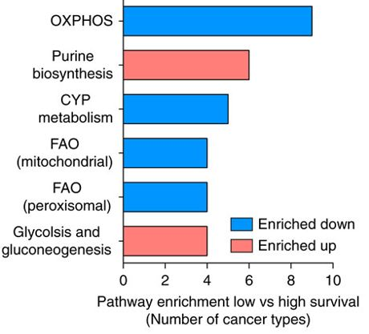
Metabolism and patient outcome
OXPHOS is suppressed
in low survival patients

Slide 27
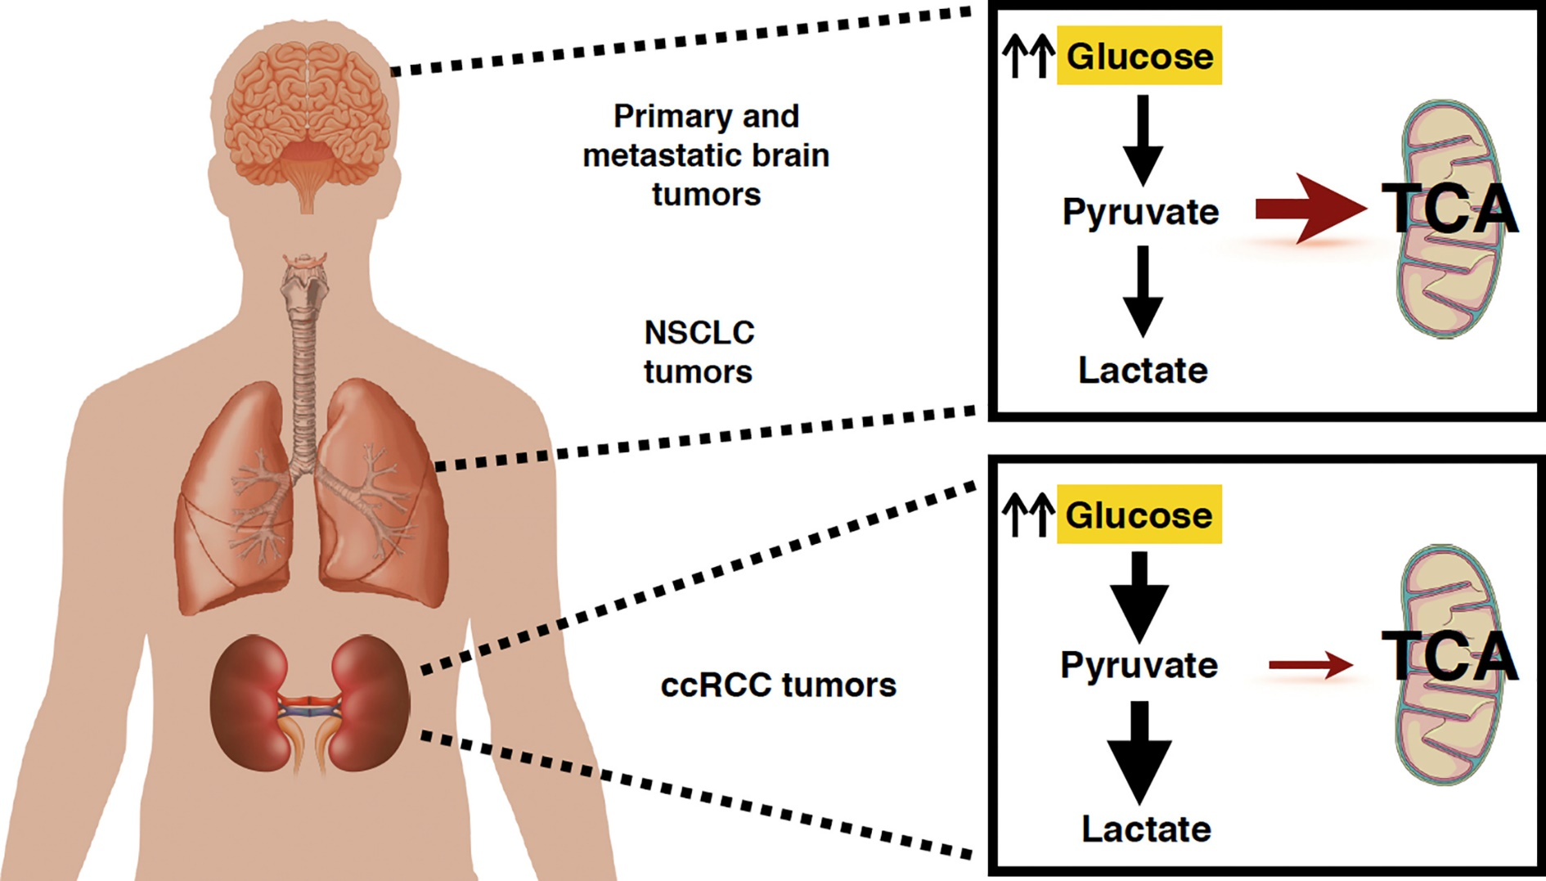
Evidence from in vivo experiments
Cell Metabolism Volume 28, Issue 5, (November 2018)

Slide 28
Can Mitochondrial dysfunction be a cancer driver?

Slide 29
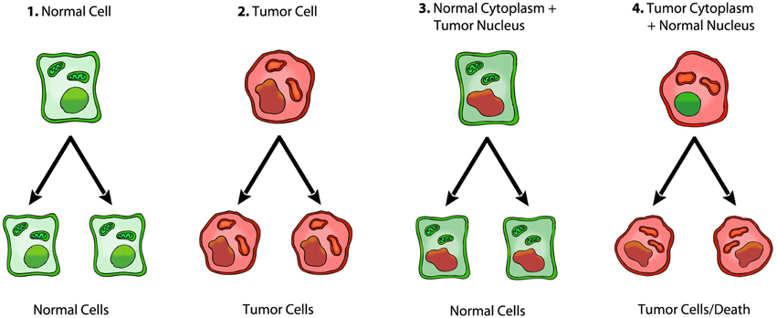
Oncogenic roles of dysfunctional mitochondria

Slide 30
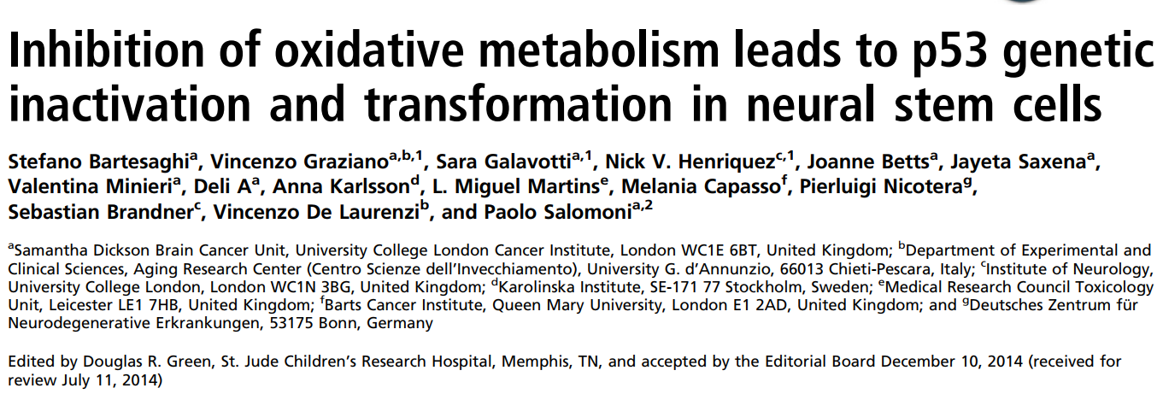
Mitochondrial dysfunction can be oncogenic

Slide 31
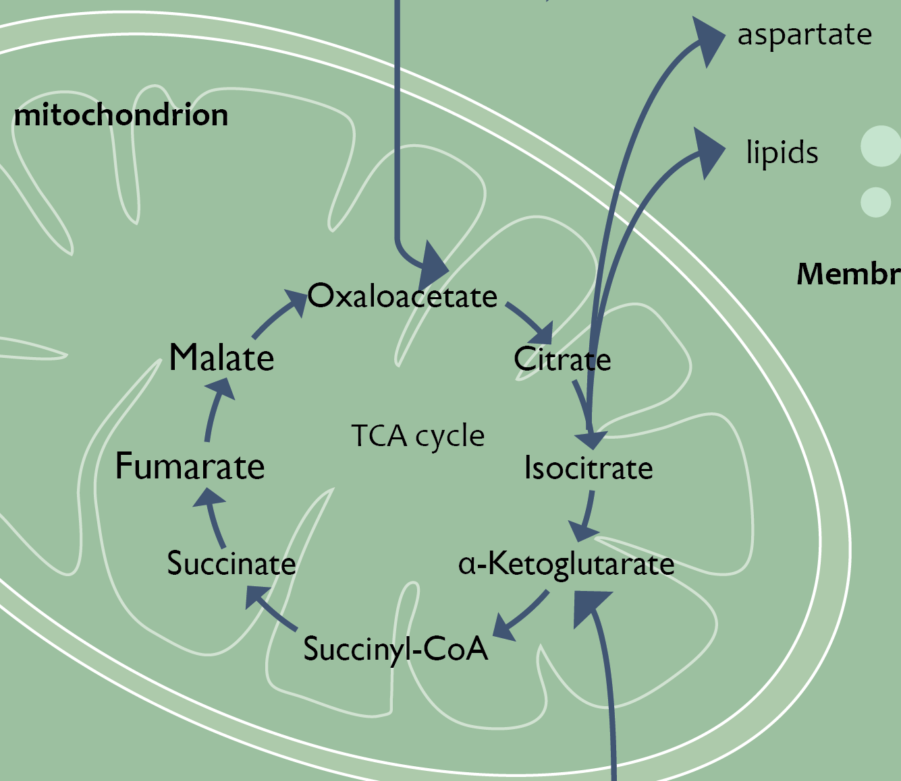
Mitochondrial dysfunction drives cancer
Metabolic dysregulation
FH
Krebs cycle
SDH
IDH
Transformation
FH=Fumarate Hydratase
SDH=Succinate Dehydrogenase
IDH=Isocitrate Dehydrogenase

Slide 32
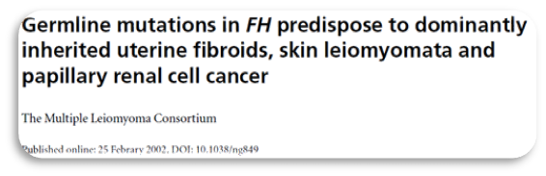
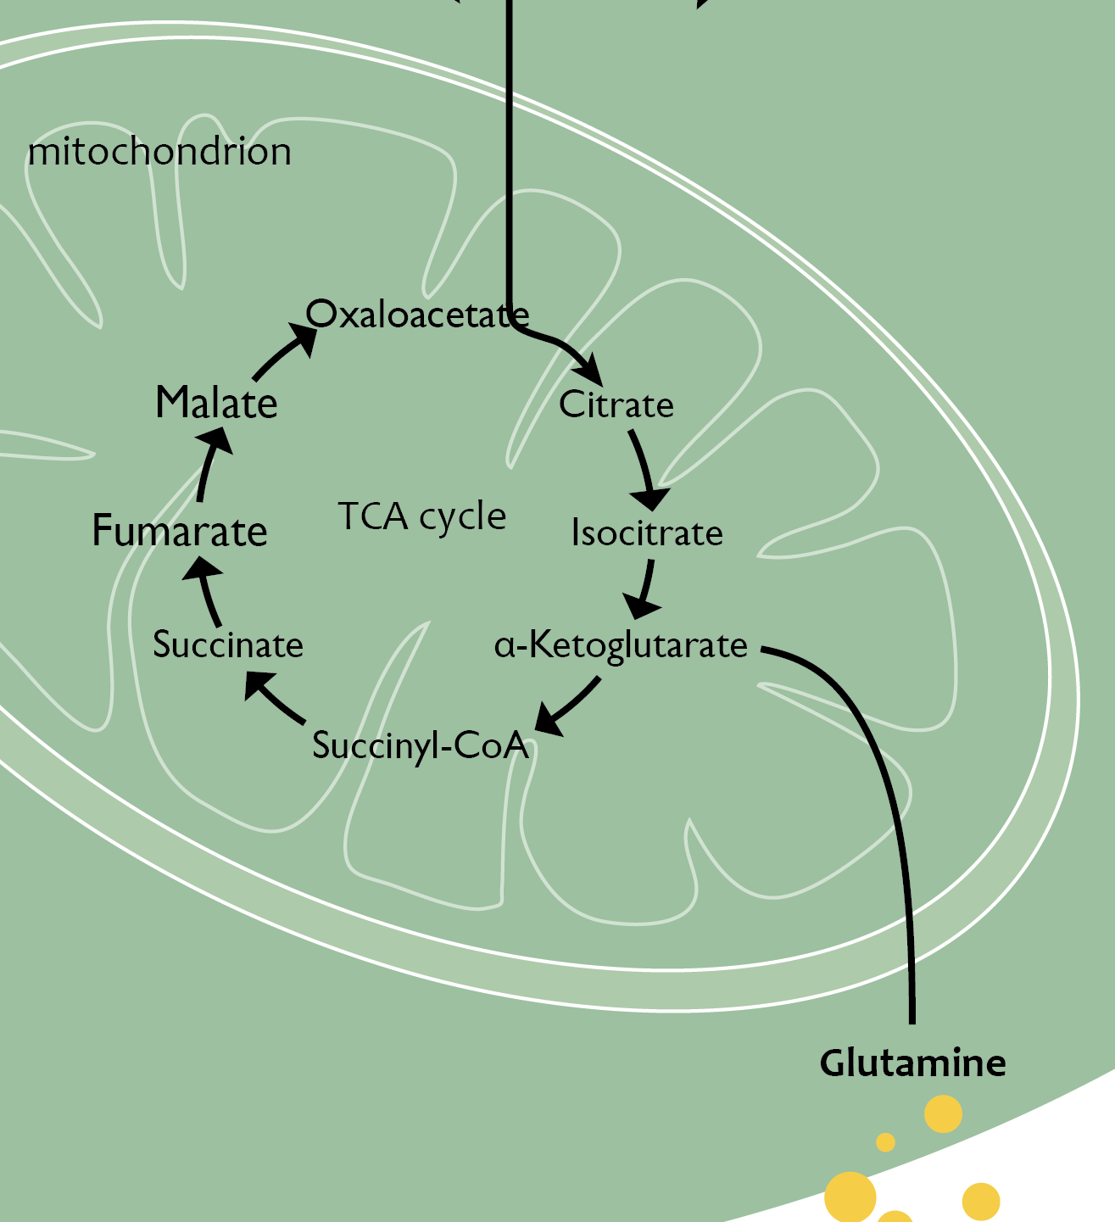
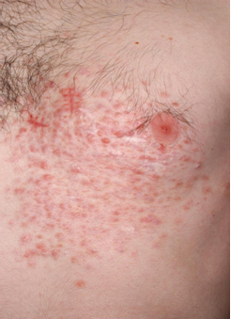
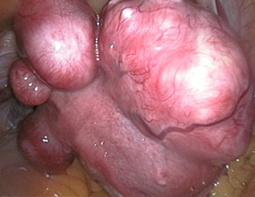
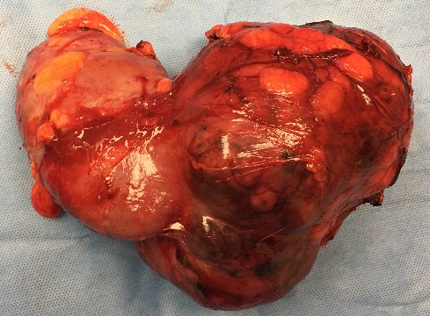
FH mutations cause HLRCC
HLRCC
Benign tumours of the skin and uterus
Papillary type 2 renal cell carcinoma
FH
uterus
kidney
tumour

Slide 33
Fumarate accumulates in FH-deficient cells
FH

Slide 34
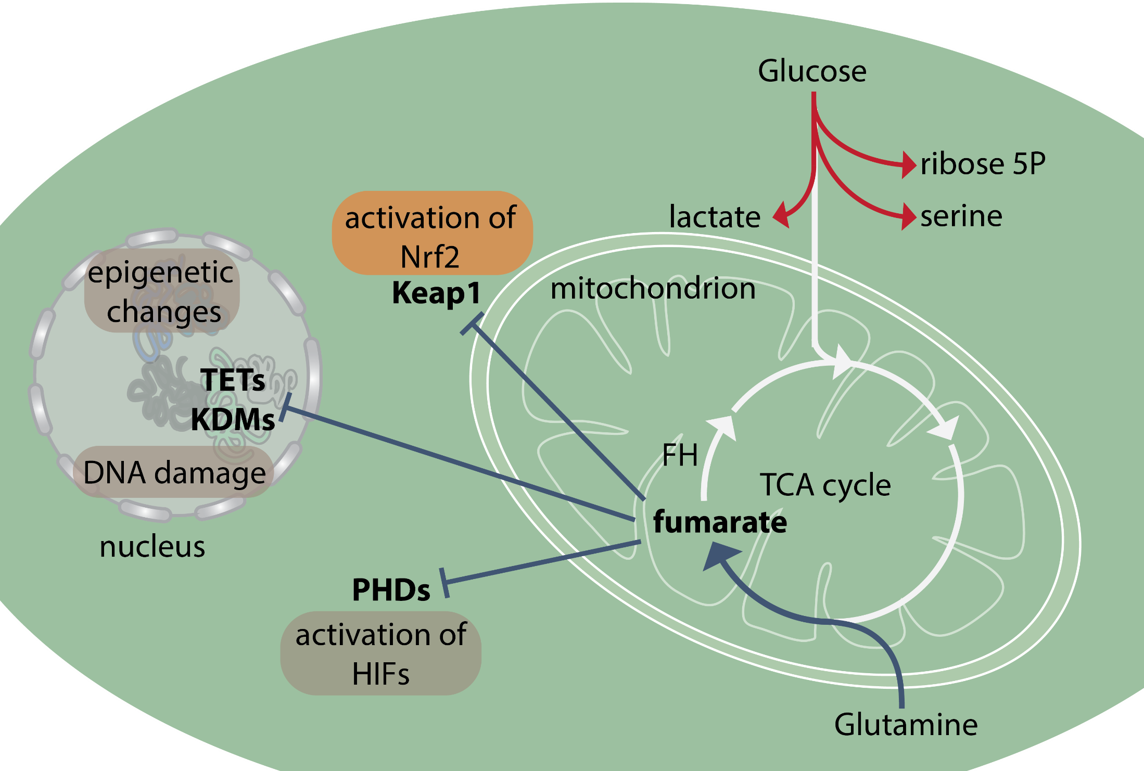
FUMARATE: AN ONCOMETABOLITE

Slide 35
Mitochondria dysfunction in cancer?
Mitochondrial function is rewired in cancer cells, in a context-dependent manner
Mitochondrial dysfunction can activate oncogenic processes

Slide 36
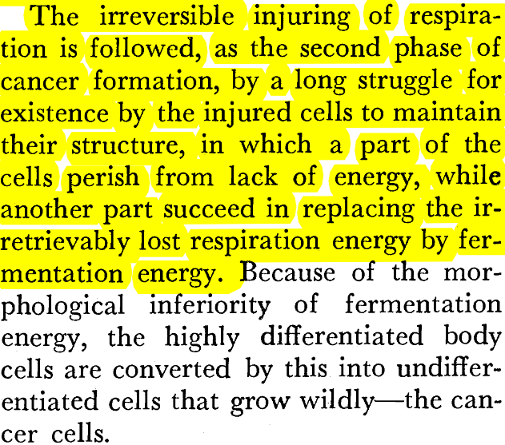
The Warburg hypothesis
Injury of respiration
Aerobic glycolysis
De-differentiation
Phase I
Phase II
Phase III

Slide 37
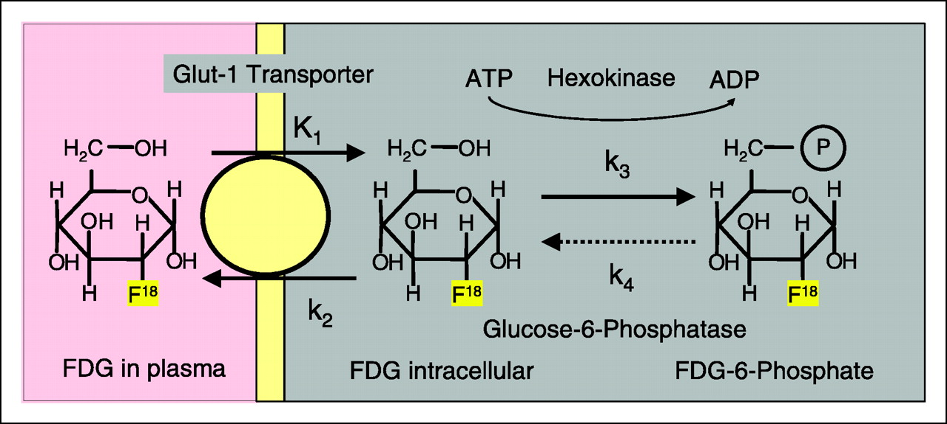
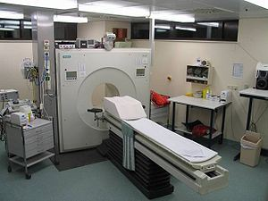
Aerobic glycolysis in cancer
[¹⁸F]flouro-2-deoxyglucose (FDG) Positron Emission Tomography (PET)

Slide 38
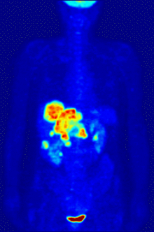
FDG-PET shows increase in glucose uptake in cancer
https://en.wikipedia.org/wiki/Positron_emission_tomography

Slide 39
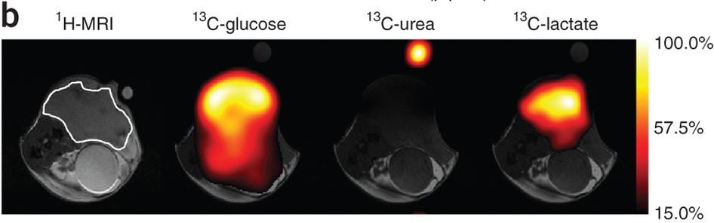
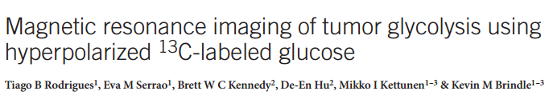
imaging of cancer metabolism

Slide 40
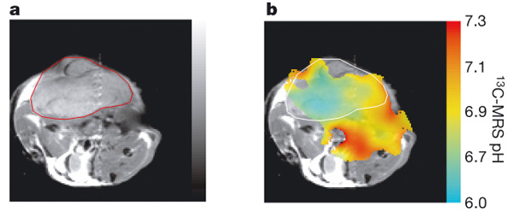
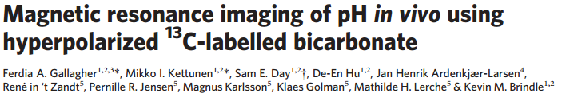
imaging of cancer metabolism
subcutaneously implanted EL4 tumour
pH map

Slide 41
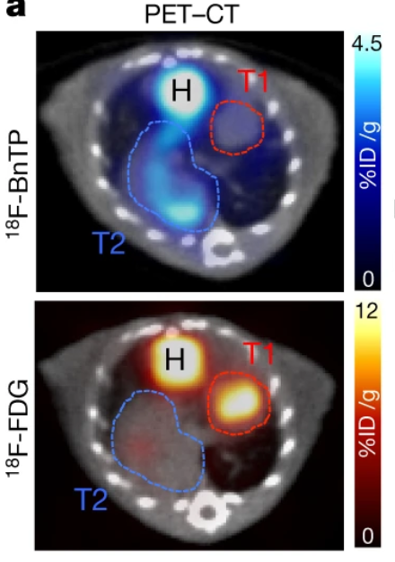
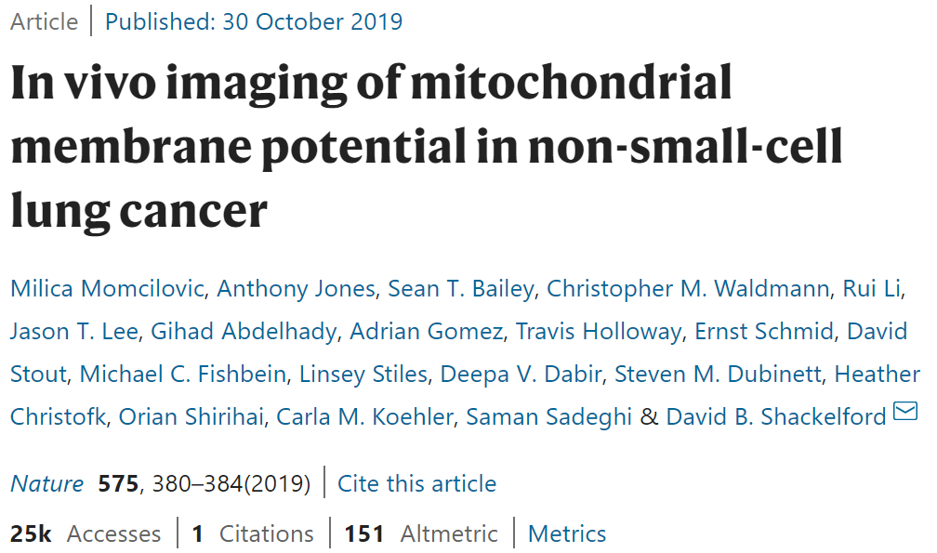
Imaging cancer metabolism
PET-CT
Mitochondrial potential
4-[¹⁸F]fluorobenzyl-triphenylphosphonium
Glycolysis

Slide 42
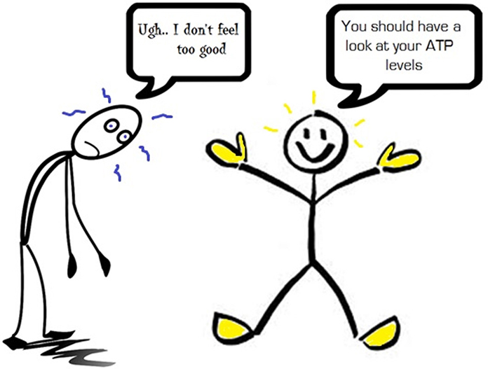
Is it all about ATP?

Slide 43

Illustration by John DiGianni/Dana-Farber Cancer Institute Department of Communications

Slide 44
Aerobic glycolysis supports proliferation

Slide 45


Aerobic glycolysis and migration

Slide 46


Overexpression of glycolytic enzymes drive cancer

Slide 47
Is glycolysis up-regulated in cancer?
Aerobic glycolysis is a hallmark of cancer
Yet, Aerobic glycolysis is a characteristic of most proliferating cells
Aerobic glycolysis provides building blocks for cancer cell growth

Slide 48

The Warburg hypothesis
Injury of respiration
Aerobic glycolysis
De-differentiation
Phase I
Phase II
Phase III

Slide 49

Aerobic glycolysis and “stemness”

Slide 50

Cancer stem cells and plasticity

Slide 51
Some complications….
EMERGING CONCEPTS IN CANCER METABOLISM

Slide 52
DYSREGULATED METABOLISM: A HALLMARK OF CANCER
Transformation
Metabolic dysregulation

Slide 53
DYSREGULATED METABOLISM: A HALLMARK OF CANCER
Transformation
Metabolic dysregulation
Biosynthesis
Energy
Redox

Slide 54


The metabolic hallmarks of cancer
Cell Metabolism 2016 23, 27-47DOI: (10.1016/j.cmet.2015.12.006)
Copyright © 2016 Elsevier Inc. Terms and Conditions

Slide 55

Intrinsic metabolic heterogeneity of cancer
Cell Metabolism
Volume 30, Issue 3, 3 September 2019, Pages 434-446

Slide 56

TUMOUR MICROENVIRONMENT AFFECTS METABOLISM
Biancur et al, BBA 2018

Slide 57

CANCER METABOLISM EVOLVES OVER TIME
DeBerardinis and Chandel , Sci Adv 2016

Slide 58

Starving cancer to death
nutrients
Cancer cell
https://discoverysedge.mayo.edu/2017/09/06/starving-cancer/

Slide 59

The first example of targeting cancer metabolism?

Slide 60

Targeting cancer metabolism (2010)
2HG
IDH*

Slide 61

Targeting cancer metabolism (2018)
2HG
IDH*

Slide 62

IDH and GLS inhibitors are in clinic

Slide 63


Slide 64

Resistance through metabolic reprogramming

Slide 65
Conclusions
Metabolism of cancer cells is different from that of normal cells
Dysregulated metabolism can drive oncogenic processes
Altered metabolism offers a therapeutic window to target cancer cells

Slide 66

Key references & links
O. Warburg, On the origin of cancer cells, Science, 1956
JS. Flier et al. Elevated levels of glucose transport and transporter messenger RNA are induced by ras or src oncogenes. Science, 1987
H. Shim et al. c-Myc transactivation of LDH-A: Implications for tumor metabolism and growth, PNAS, 1998
D. Hanahan and RA. Weinberg, Hallmarks of Cancer: next generation, Cell, 2011
Gaude and Frezza, Tissue-specific and convergent metabolic transformation of cancer correlates with metastatic potential and patient survival, Nat Comms, 2016
Pavlova and Thompson, The emerging hallmarks of cancer metabolism, Cell Metabolism, 2016
Sanderson et al, Revisiting the Warburg Effect: Some Tumors Hold Their Breath, Cell Metabolism 2018
Follow us on Twitter @FrezzaLab

