Slide 1

Overview of the core ideas in cancer research
Paul Edwards
CRUK Cambridge Institute, Hutchison-MRC research centre
and Department of Pathology, University of Cambridge

Slide 2
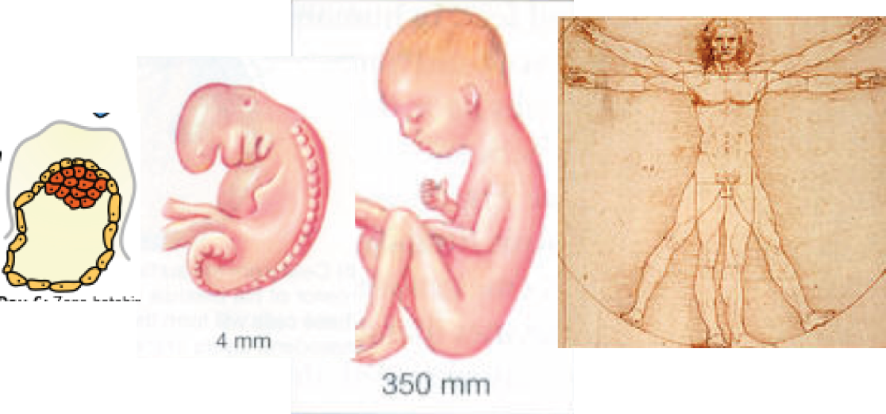
What is Cancer ?
Notes:
From egg to embryo to adult and throughout adult life cells grow and organise themselves in 3 D. In the adult there is constant turnover, e.g. in the gut, and if a tissue is wound cells migrate and divide to close the wound. From time to time rogue cells arise that don’t obey the rules and grow more than they should – they may take over a patch of tissue, dis[placing their neighbours, or make the tissue grow more than it should. In the worst case, cells escape from their home location and seed new colonies all over the body – this is cancer.

Slide 3
What is Cancer ?

Slide 4
What is Cancer ?

Slide 5
What is Cancer ?

Slide 6
What is Cancer ?

Slide 7
What is Cancer ?
failure of 3-D growth control
and repair/wound healing

Slide 8
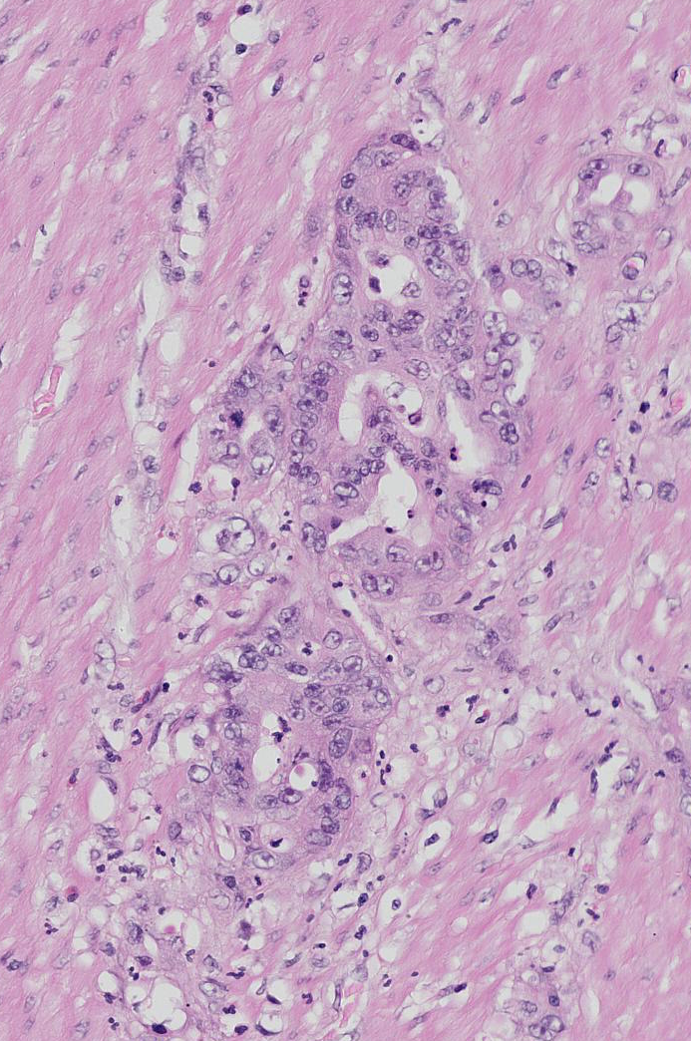
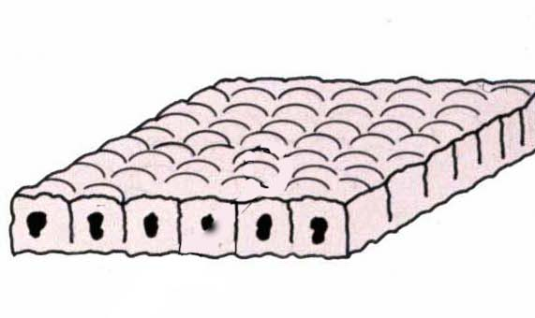
What is Cancer ?
failure of 3-D growth control
and repair/wound healing

Slide 9
Cancer is caused by
alteration of a cell’s genes
Normal
Cell
Slightly
Abnormal
More
Abnormal
Malignant
mutations/Gene changes
Notes:
dont know how many stages
.. but what do we mean by a cancer and what do we mean by a Malignant cancer?

Slide 10
Cancer is caused by
alteration of a cell’s genes
Normal
Cell
Slightly
Abnormal
More
Abnormal
Malignant
Gene changes
mutations (all kinds) + epigenetic change + viruses
+ mobile elements, etc
Notes:
dont know how many stages
.. but what do we mean by a cancer and what do we mean by a Malignant cancer?

Slide 11
Cancer is caused by
alteration of a cell’s genes
Normal
Cell
Slightly
Abnormal
More
Abnormal
Malignant
unknown number
Gene changes
Notes:
dont know how many stages
.. but what do we mean by a cancer and what do we mean by a Malignant cancer?

Slide 12
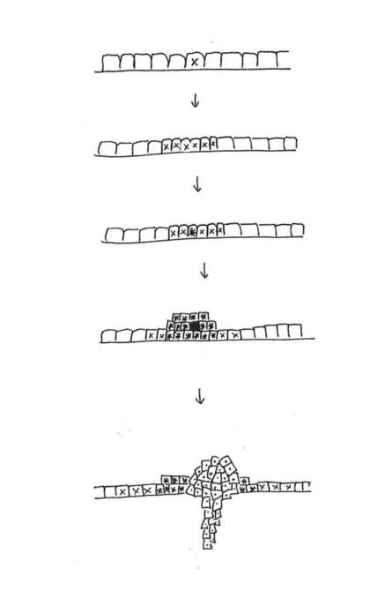
Tumours develop by Clonal Evolution = Natural Selection
‘progression’
Evidence that tumours are
clonal is that cells have the
same mutations
Notes:
mention progression, heterogeneity

Slide 13
so tumours develop in stages by successive clonal expansions; mutation that leads to lack of expansion is unlikley to lead to further development; note that, in bulk, tumours will be a mix of clones, with the most recent/aggressive generally a minor clone

Slide 14
genetic instability

Slide 15
Development of a cancer
Normal
Cell
Slightly
Abnormal
More
Abnormal
Malignant
?
Gene changes/mutations
?
accelerated by Genetic Instability
Notes:
dont know how many stages
.. but what do we mean by a cancer and what do we mean by a Malignant cancer?

Slide 16
Human cancers are often Genetically Unstable
Most human cancers seem to show genetic instability of some kind
Not just a consequence of malignancy (e.g. rapid cell cycling) because:
different tumours have different instability

Slide 17
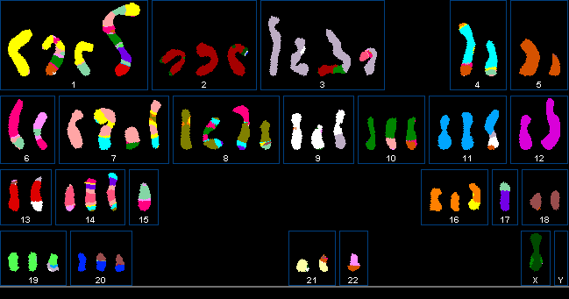
Genetic Instability is a Specific Abnormality
Genetic Instability is a Specific Abnormality
chromosomes stable
Tumour A
Sequence instability
100X rate single-base mutations
Tumour B
chromosome instability
‘CIN’
Sequences stable

Slide 18
Genetic Instability is a Specific Abnormality
Genetic Instability is a Specific Abnormality
chromosomes stable
Tumour A
Sequence instability
e.g. Mutation in mismatch DNA repair
Tumour B
chromosome instability
‘CIN’
Sequences stable
e.g. Mutation in strand break repair

Slide 19
Genetic Instability:
Basic proposition: Cancers arise in cells that are genetically unstable
Theoretical Argument (controversial): so many mutations are needed for cancer that they would rarely happen at normal mutation rate.
Lots of different types/mechanisms
Notes:
Evidence: Colon cancers can show microsatellite (sequence-level) instability (MIN) OR Chromosome instability (CIN) (occasionally both). Since most MIN tumours don’t show CIN and vice versa, neither is merely a consequence of malignancy or rapid cell cycling

Slide 20
How could genetic instability come about?
 | Sequence instability | chromosome instability
Failure to repair DNA damage | √ | √
Errors in replication or mitosis | √ | √

Slide 21
How could genetic instability come about?
 | Sequence instability | chromosome instability
Failure to repair DNA damage | √ | √
Errors in replication or mitosis | √ | √
e.g. mismatch
repair
~15% colon cancers have mutations in DNA mismatch repair
-> high point mutation rate and repeat expansion/contraction
(“microsatellite instability”)

Slide 22
How could genetic instability come about?
 | Sequence instability | chromosome instability
Failure to repair DNA damage | √ | √
Errors in replication or mitosis | √ | √
e.g. mismatch
repair
e.g. BRCA1, BRCA2

Slide 23
How could genetic instability come about?
perhaps:
 | Sequence instability | chromosome instability
Failure to repair DNA damage | √ | √
Errors in replication or mitosis | √ | √
e.g. mismatch
repair
e.g. BRCA1, BRCA2
e.g. polymerase mutant
some colon cancers have mutations in DNA polymerase epsilon
very high point mutation rate
Notes:
13/224= jut over 5% cases in TCGA CRC data 2012 see also Tomlinson review of POLE and POLD mutations, more like 3% quoted

Slide 24
How could genetic instability come about?
 | Sequence instability | chromosome instability
Failure to repair DNA damage | √ | √
Errors in replication or mitosis | √ | √
e.g. mismatch
repair
e.g. BRCA1, BRCA2
e.g. polymerase mutant
e.g. lagging chromosomes

Slide 25
Errors in mitosis:Abnormal mitosis End
Movie by Duane Compton and Sarah Thompson, Dartmouth USA

Slide 26
There are many kinds of genetic instability
perhaps:
For most human cancers we don’t yet know what their genetic instability is
 | Sequence instability | chromosome instability
Failure to repair DNA damage | √ | √
Errors in replication or mitosis | √ | √
e.g. mismatch
repair
e.g. BRCA1, BRCA2
target for therapy!
e.g. polymerase epsilon mutant
e.g. lagging
chromosomes
......and there is probably Epigenetic instability as well !
......and activation of mobile elements

Slide 27
Oncogenes and Tumour Suppressor genes
Definitions vary but one is:
Oncogene mutations are overactivity mutations
Tumour Supppressor Gene mutations are loss of function mutations
Notes:
animated

Slide 28
Oncogenes versus Tumour Suppressor Genes
Normal
Abnormal
Oncogene
classic
Tumour
suppressor
gene
Somewhat
Abnormal
some
Tumour
suppressor
genes,
e.g. p53

Slide 29
Oncogenes and Tumour Suppressor genes
Definitions vary but one is:
Oncogene mutations are overactivity mutations
- dominant in the cell, I.e. only one copy mutated
Tumour Supppressor Gene mutations are loss of function mutations
- generally both copies are mutated, recessive in the cell
Notes:
animated

Slide 30
hereditary predisposition

Slide 31
hereditary predisposition
NOT QUITE
Normal
Cell
Slightly
Abnormal
More
Abnormal
Malignant
•
•
Gene changes / mutations
- either growth control or genetic instability
- v. important genetic diseases

Slide 32
hereditary predisposition examples
 | gene
Retinoblastoma | Rb1
Polyposis coli (colon) | APC
Lynch syndrome (mostly colon) | MLH1 (mismatch repair)
Breast | BRCA2
growth control
genetic instability
(DNA repair)

Slide 33
What do gene changes do to cells ?
not just control of cell proliferation

Slide 34
Malignant cells have acquired a number of properties
- The ‘Hallmarks of Cancer’
(Hanahan & Weinberg, 2000, revised 2011)
Abnormal proliferation
and survival control: Independence of positive growth signals
Resistance to negative signals
Resistance to Apoptosis, cycle arrest
Abnormal (often blocked) Differentiation
Immortality/resistance to stress arrest
Genetic Instability
Metastasis ?
Angiogenesis ?
Metabolic changes?
Immune response?
Notes:
Multiple types of CIN

Slide 35
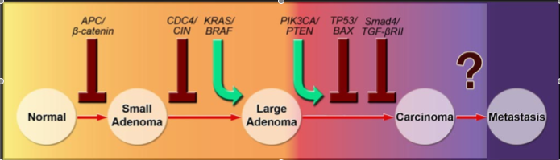
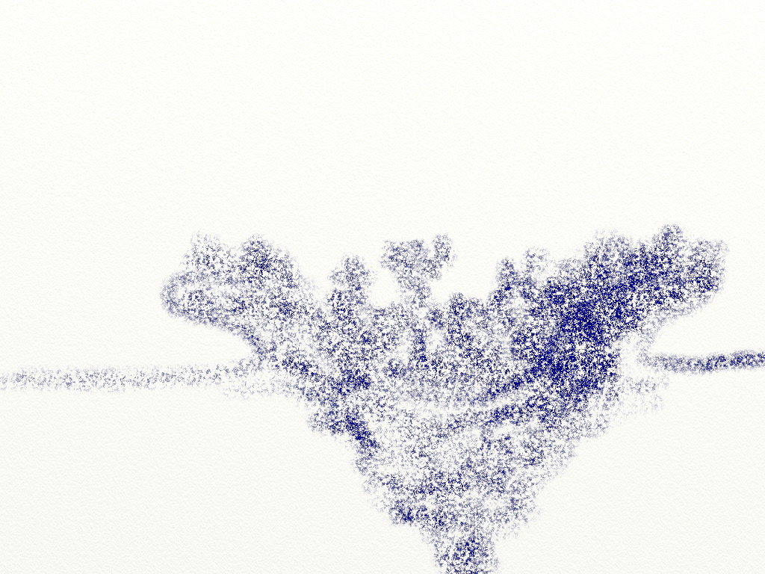

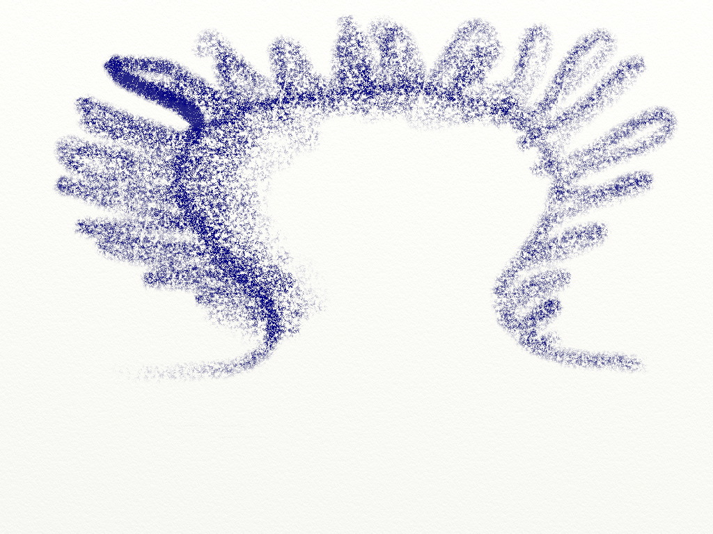

Vogelstein’s model of colon cancer (2008 version)
Tumour suppressor gene
Oncogene
Jones S et al. Proc Natl Acad Sci USA. 2008
Benign
Malignant
Notes:
Jones et al, 2008

Slide 36
Malignant cells have acquired a number of properties
- The ‘Hallmarks of Cancer’
(Hanahan & Weinberg, 2000, revised 2011)
Abnormal proliferation
and survival control: Independence of positive growth signals
Resistance to negative signals
Resistance to Apoptosis, cycle arrest
Abnormal (often blocked) Differentiation
Immortality/resistance to stress arrest
Genetic Instability
Metastasis ?
Angiogenesis ?
Metabolic changes?
Immune response?
Notes:
Multiple types of CIN

Slide 37
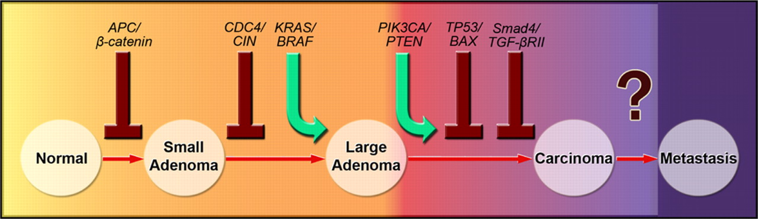
Vogelstein’s model of colon cancer (2008 version)
external growth promoting signals
Wnt
Tyr kinase
Jones S et al. Proc Natl Acad Sci USA. 2008

Slide 38
Vogelstein’s model of colon cancer (2008 version)
external growth inhibitory signals
Wnt
Tyr kinase
TGF-β

Slide 39
Vogelstein’s model of colon cancer (2008 version)
anti apoptosis/cycle arrest
Wnt
Tyr kinase
TGF-β

Slide 40
Vogelstein’s model of colon cancer (2008 version)
genetic instability
Wnt
Tyr kinase
TGF-β

Slide 41
Malignant cells have acquired a number of properties
- The ‘Hallmarks of Cancer’
(Hanahan & Weinberg, 2000, revised 2011)
Abnormal proliferation
and survival control: Independence of positive growth signals
Resistance to negative signals
Resistance to Apoptosis, cycle arrest
Abnormal (often blocked) Differentiation
Immortality/resistance to stress arrest
Genetic Instability
Metastasis ?
Angiogenesis ?
Metabolic changes?
Immune response?
Notes:
Multiple types of CIN

Slide 42
Vogelstein’s model of colon cancer (2008 version)
Tyr kinase
TGF-β

Slide 43
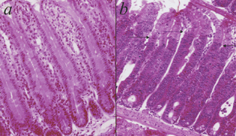
Deleting the APC gene in colon
Wild-type
APC deleted
Crypt region
Crypt region has expanded
Sansom, O.J. et al., 2004. Genes & development

Slide 44
Malignant cells have acquired a number of properties
- The ‘Hallmarks of Cancer’
(Hanahan & Weinberg, 2000, revised 2011)
Abnormal proliferation
and survival control: Independence of positive growth signals
Resistance to negative signals
Resistance to Apoptosis, cycle arrest
Abnormal (often blocked) Differentiation
Immortality/resistance to stress arrest
Genetic Instability
Metastasis ?
Angiogenesis ?
Metabolic changes?
Immune response?
Notes:
Multiple types of CIN

Slide 45
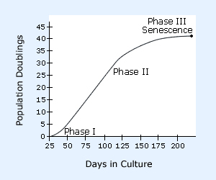
The Hayflick Limit: ‘Senescence’

Slide 46
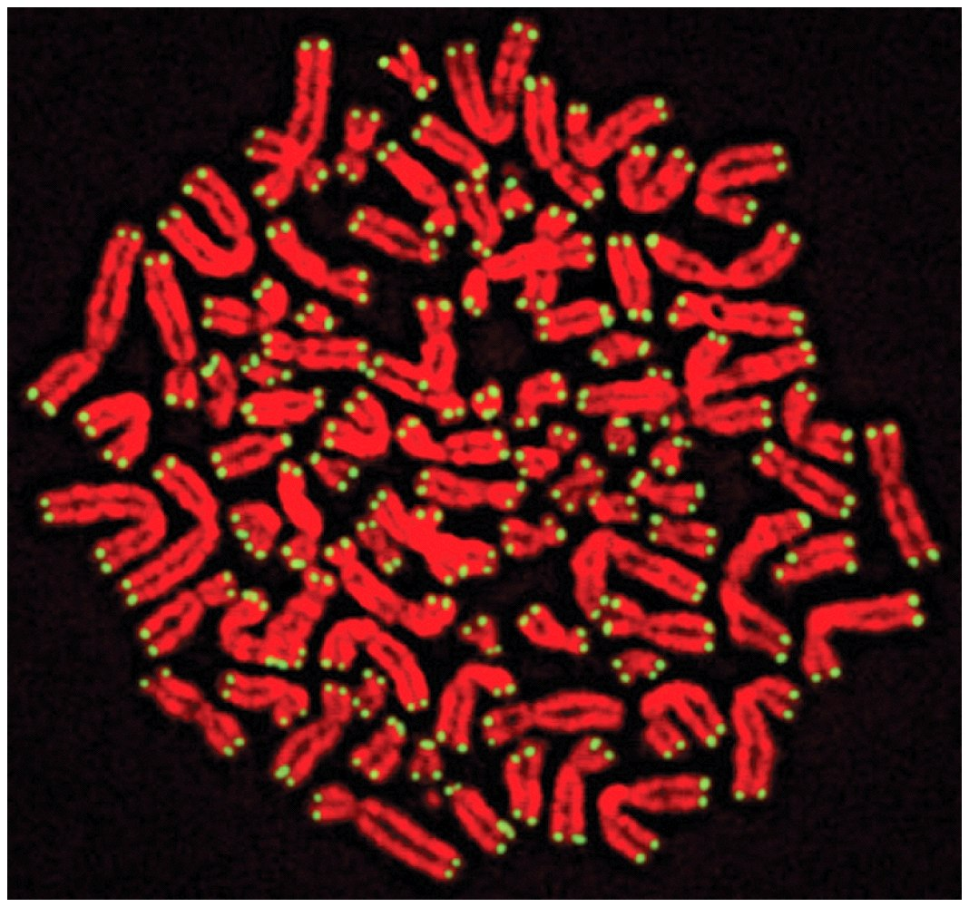
Immortality, Telomeres & Senescence
Senescence: Cells in culture cycle arrest after a set number of divisions.
Immortalisation: certain cancer mutations can take cells through this block –Cancer cells are ‘immortalised’
Divisons are measured by telomeres: Telomeres shorten at DNA replication
short telomeres -> senescence.
Expression of telomerase-> immortality

Slide 47
Immortality, Telomeres & Senescence
Senescence: Cells in culture cycle arrest after a number of divisions.
Senescence is now recognised as a stress response

Slide 48
Senescence is now recognised as a stress response
Telomere
shortening
‘sensescence’
phenotype

Slide 49
Senescence is now recognised as a stress response
Telomere
shortening
DNA
damage
Abnormal
signalling
etc.
Stresses
‘sensescence’
phenotype

Slide 50
Malignant cells have acquired a number of properties
- The ‘Hallmarks of Cancer’
(Hanahan & Weinberg, 2000, revised 2011)
Abnormal proliferation
and survival control: Independence of positive growth signals
Resistance to negative signals
Resistance to Apoptosis, cycle arrest
Abnormal (often blocked) Differentiation
Immortality/resistance to stress arrest
Genetic Instability
Metastasis ?
Angiogenesis ?
Metabolic changes?
Immune response?
Notes:
Multiple types of CIN

Slide 51
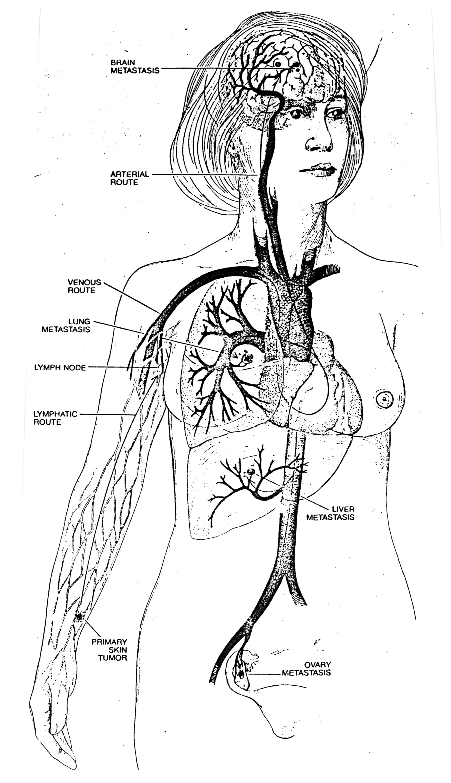
Malignancy/ Metastasis is the central problem, both clinically and intellectually
Notes:
51

Slide 52
Vogelstein’s model of colon cancer (2008 version)
Jones S et al. Proc Natl Acad Sci USA. 2008
Notes:
Jones et al, 2008

Slide 53
Malignancy, Invasion & Metastasis
Most that is written is a priori and therefore at best suspect, e.g.
‘invasion out of vessels is abnormal’
- wrong, normal cells exit vessels efficiently (Chambers)
‘a small subpopulation of primary tumour is uniquely capable of metastasis’
- probably wrong (Kerbel, Weiss, Weinberg & Bernards)
‘malignant cells are abnormally motile’
- not clear, normal epithelial cells can travel much faster than cancers, not possible to do the comparison in vivo
‘tumour cells are invasive’
- depends what you mean by ‘invasive’. Tumours spread but it’s not clear how active this is. In some experimental systems, normal cells can be more invasive than their cancers

Slide 54
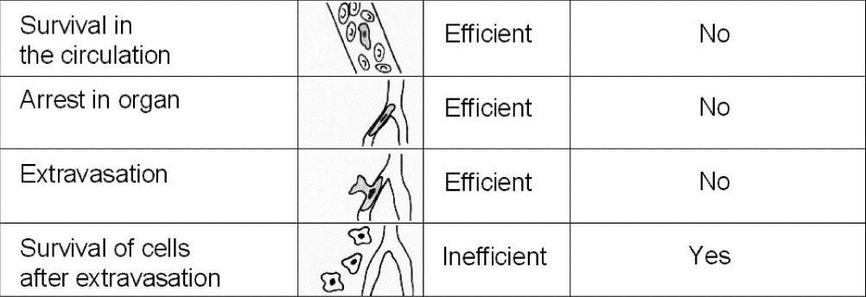
Malignancy, Invasion & Metastasis
(exit into circulation)
TEXTBOOKS
Inefficient -cells die
Abnormal
Abnormal, difficult
abnormal

Slide 55
Malignancy, Invasion & Metastasis
(exit into circulation)
Experiment - Ann Chambers
TEXTBOOKS
Inefficient -cells die
Abnormal
Abnormal, difficult
abnormal

Slide 56
Malignancy, Invasion & Metastasis
Experiment - Ann Chambers
TEXTBOOKS
Inefficient -cells die
Abnormal
Abnormal, difficult
abnormal
only barrier to metastasis

Slide 57
Malignancy, Invasion & Metastasis
Most that is written is a priori and therefore at best suspect, e.g.
‘invasion out of vessels is abnormal’
- wrong, normal cells exit vessels efficiently (Chambers)
‘a small subpopulation of primary tumour is uniquely capable of metastasis’
- probably wrong (Kerbel, Weiss, Weinberg & Bernards)
‘malignant cells are abnormally motile’
- not clear, normal epithelial cells can travel much faster than cancers, not possible to do the comparison in vivo
‘tumour cells are invasive’
- depends what you mean by ‘invasive’. Tumours spread but it’s not clear how active this is. In some experimental systems, normal cells can be more invasive than their cancers

Slide 58
Malignancy, Invasion & Metastasis
Most that is written is a priori and therefore at best suspect, e.g.
‘invasion out of vessels is abnormal’
- wrong, normal cells exit vessels efficiently (Chambers)
‘a small subpopulation of primary tumour is uniquely capable of metastasis’
- probably wrong (Kerbel, Weiss, Weinberg & Bernards)
‘malignant cells are abnormally motile’
- not clear, normal epithelial cells can travel much faster than cancers, not possible to do the comparison in vivo
‘tumour cells are invasive’
- depends what you mean by ‘invasive’. Tumours spread but it’s not clear how active this is. In some experimental systems, normal cells can be more invasive than their cancers

Slide 59

Leonard Weiss’s retransplantation expt
‘Only some of the cells in a tumour can metastasize’.
test
Primary tumour
?
transplant
test
metastasis
=> No evidence for special metastatic subpopulation
No evidence for major mutation/selection between primary and metastasis

Slide 60
Leonard Weiss’s retransplantation expt
Primary tumour
test
transplant
test
metastasis

Slide 61
Leonard Weiss’s retransplantation expt
Primary tumour
test
transplant
Equal rate of
metastasis
test
metastasis
=> No evidence for special metastatic subpopulation
No evidence for major mutation/selection between primary and metastasis

Slide 62
Malignancy, Invasion & Metastasis
Most that is written is a priori and therefore at best suspect, e.g.
‘invasion out of vessels is abnormal’
- wrong, normal cells exit vessels efficiently (Chambers)
‘a small subpopulation of primary tumour is uniquely capable of metastasis’
- probably wrong (Weiss + Kerbel + Weinberg & Bernards)
‘malignant cells are abnormally motile’
- not clear, normal epithelial cells can travel much faster than cancers, not possible to do the comparison in vivo
‘tumour cells are invasive’
- depends what you mean by ‘invasive’. Tumours spread but it’s not clear how active this is. In some experimental systems, normal cells can be more invasive than their cancers

Slide 63
Malignancy, Invasion & Metastasis
Most that is written is a priori and therefore at best suspect, e.g.
‘invasion out of vessels is abnormal’
- wrong, normal cells exit vessels efficiently (Chambers)
‘a small subpopulation of primary tumour is uniquely capable of metastasis’
- probably wrong (Kerbel, Weiss, Weinberg & Bernards)
‘tumour cells are invasive’
- depends what you mean by ‘invasive’. Tumours spread but it’s not clear how active this is.
-Tumours follow pre-existing channels between cells*
- In some in vitro systems, normal cells more invasive than cancers
*video in vivo by P. Friedl removed for copyright reasons

Slide 64
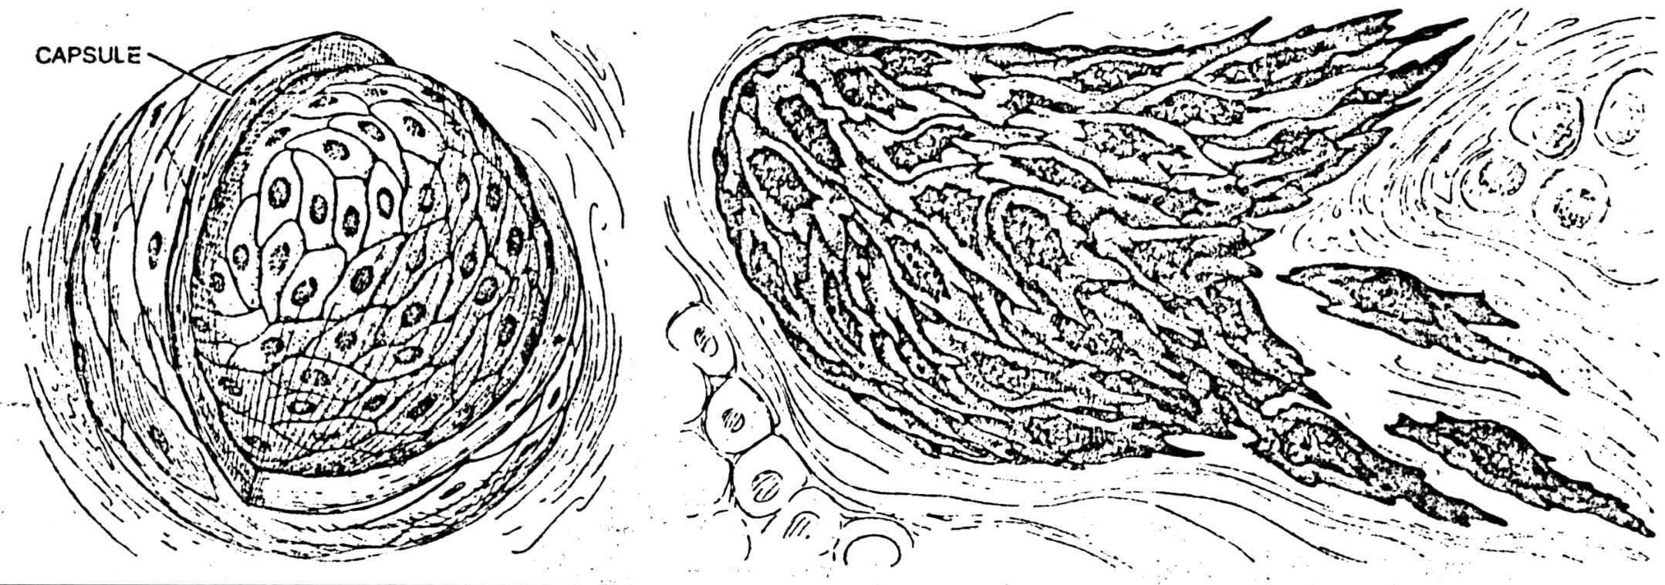
Metastasis: a personal conclusion
Malignant cells can grow in an alien environment
No evidence (yet) for a major change (e.g. crucial mutations) between malignant primary and metastasis
Pathologist’s ‘invasiveness’ is a kind of ‘local metastasis’
-> Maybe metastasis is just ‘leakage’ of cells from the primary
Malignancy is what matters

