Slide 1
Tumour pathology, structure and nomenclature
Paul Edwards
Department of Pathology and Cancer Research UK Cambridge Institute,
University of Cambridge
Notes:
Who I am

Slide 2
Core idea of cancer
Normal
Cell
Slightly
Abnormal
More
Abnormal
Malignant
Metastasis
mutations
Notes:
dont know how many stages
.. but what do we mean by a cancer and what do we mean by a Malignant cancer?

Slide 3
1. Malignancy and Metastasis
the central problem of cancer research,
both clinically and intellectually
Notes:
3

Slide 4
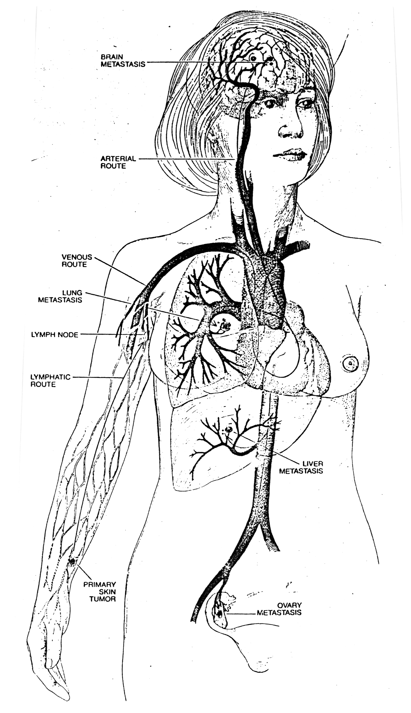
Metastasis
Notes:
4

Slide 5
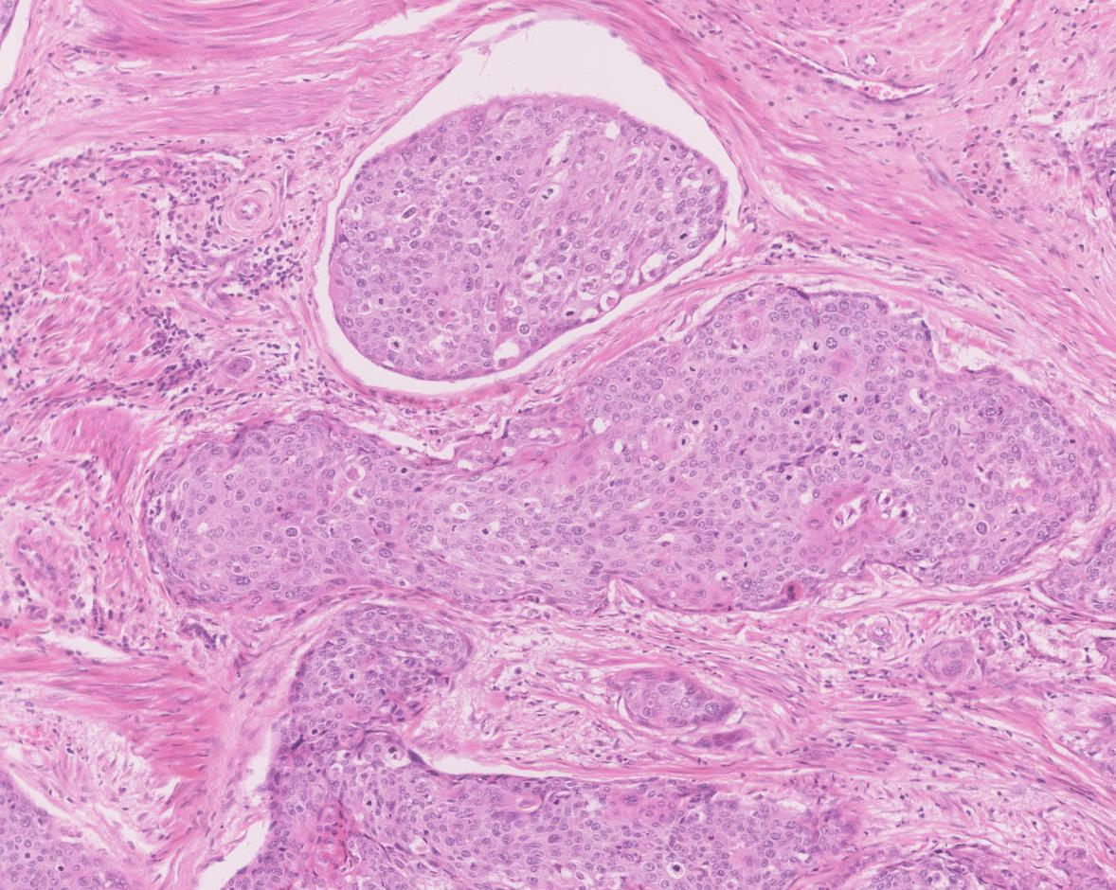
Metastasis
Tumour cells get into circulation and
seed metastases
lymphatic
Notes:
5

Slide 6
Malignancy
Benign tumour (mole)
malignant tumour (melanoma)
Notes:
6

Slide 7
Malignancy
malignant tumour (melanoma)
capable of metastasis
Notes:
7

Slide 8
1. Malignancy and Metastasis
the central problem of cancer research,
both clinically and intellectually
Metastasis is when a cancer forms additional tumours
‘secondaries’ elsewhere in the body. A metastasis is also a secondary tumour, plural metastases
Malignancy definition: the ability to form metastases (it doesn’t have to have metastasized yet)
Notes:
8

Slide 9
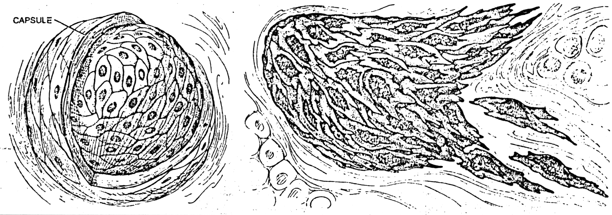
Malignancy can be identified down the microscope
benign
malignant

Slide 10
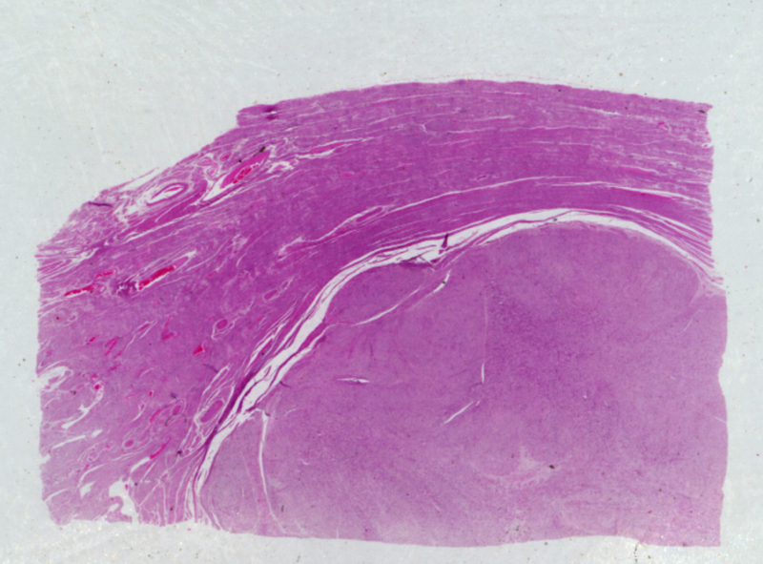
Benign smooth muscle tumour of uterus (common)

Slide 11
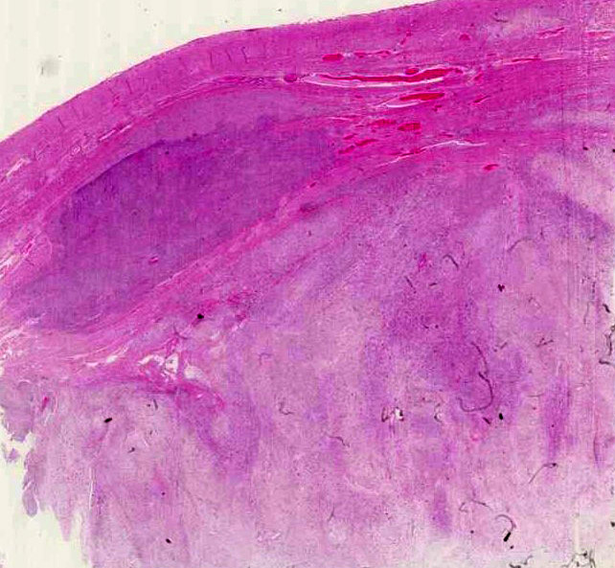
Smooth muscle tumours of uterus
Malignant Benign
(v. rare)
(common)
cells spread
cells stay where they belong

Slide 12
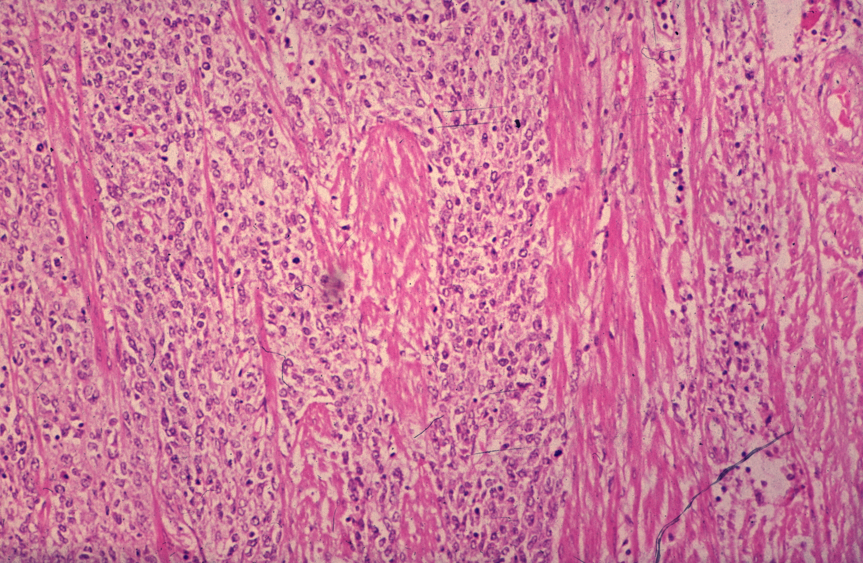
Malignant smooth muscle tumour of uterus
(v. rare)
TUMOUR
MUSCLE
Benign (common)

Slide 13
What is malignancy?
- malignancy is defined as the ability to metastasize however rarely
- what makes a tumour malignant ?
? the ability to grow in an alien environment
- can be identified down the microscope - WHY
? is what we are seeing this ability to grow into alien territory?
? is invasion actually a kind of local metastasis?

Slide 14
Malignancy WHY can be identified down the microscope
invasion = local growth in alien environment
‘local metastasis’ ?
benign
malignant

Slide 15
Malignant smooth muscle tumour of uterus: ‘invasive’
invasion = local growth in alien territory
(“local metastsis?”)

Slide 16
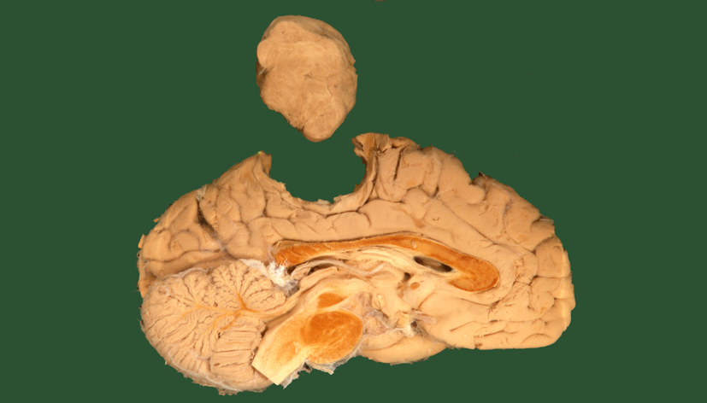
Benign tumours can kill
Benign tumours can cause death or at least disease, e.g.
meningioma,
pituitary adenomas
and benign growths can
simply obstruct

Slide 17
Nomenclature
not entirely consistent but roughly speaking:
Benign tumours:
tissue name + - oma e.g.
lipoma =benign fat tumour
Leiomyoma = benign smooth muscle tumour
Papilloma = wart
adenoma [of the colon] = benign glandular lump, including glandular polyp
Malignant tumours from mesenchyme
[name of tissue] sarcomas E.g
osteosarcoma (malignant bone tumour),
leiomyosarcoma (malignant smooth muscle)
Malignant tumours from epithelium
[name of tissue] carcinoma
e.g. breast carcinoma
Some Exceptions to the above rules:
malignant melanoma
Neuroblastoma
Haemopoietic system:
Leukaemias liquid neoplasms
lymphoma solid lymphocytic neoplasms
malignant

Slide 18
Leukaemias
 | Myeloid | Lymphocytic
Acute | AML | ALL
Chronic | CML | CLL
Leukaemias are liquid, mainly in blood. Lymphomas are related proliferations of lymphocytes as solid masses mainly in lymph nodes

Slide 19
Incidence
Benign tumours:
very common all tissues
Leiomyoma of uterus, lipoma, wart, mole ….
Malignant tumours from mesenchyme
generally rare but often rapidly lethal
E.g osteosarcoma (malignant bone tumour),
Malignant tumours from epithelium
Common - most important cancers
e.g. breast carcinoma,
colorectal
lung,
ovary
prostate
Liver (low in West, high elsewhere, HBV + aflatoxin)
Cervix (HPV)
Nasopharyngeal (chinese, EBV))
main virus-associated cancers

Slide 20
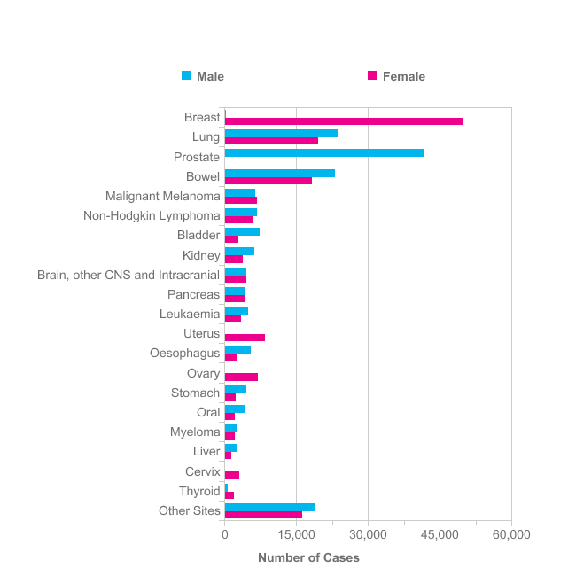
The 20 Most Common Cancers
New Cases, UK, 2011
Half of all cases
http://info.cancerresearchuk.org/cancerstats

Slide 21
Core idea of cancer
Normal
Cell
Slightly
Abnormal
More
Abnormal
Malignant
Metastasis
some of these abnormal patterns can be seen
mutations
Notes:
dont know how many stages
.. but what do we mean by a cancer and what do we mean by a Malignant cancer?

Slide 22
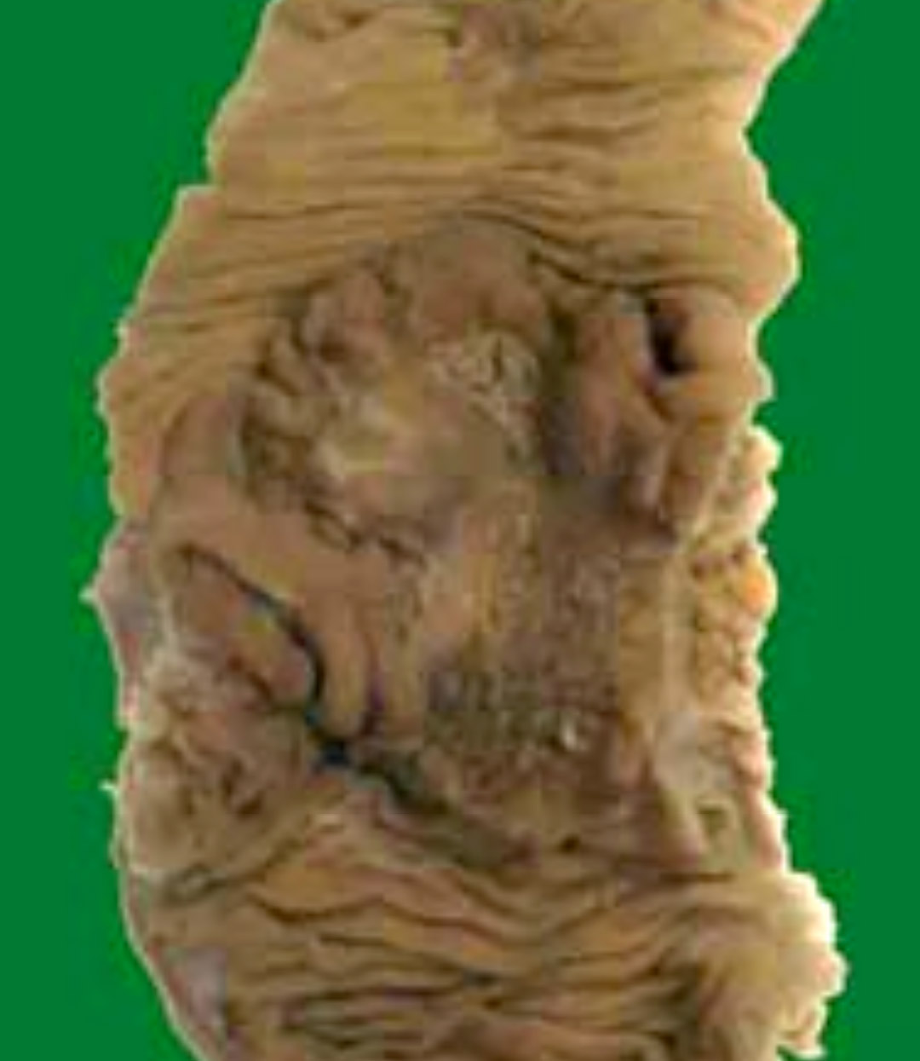
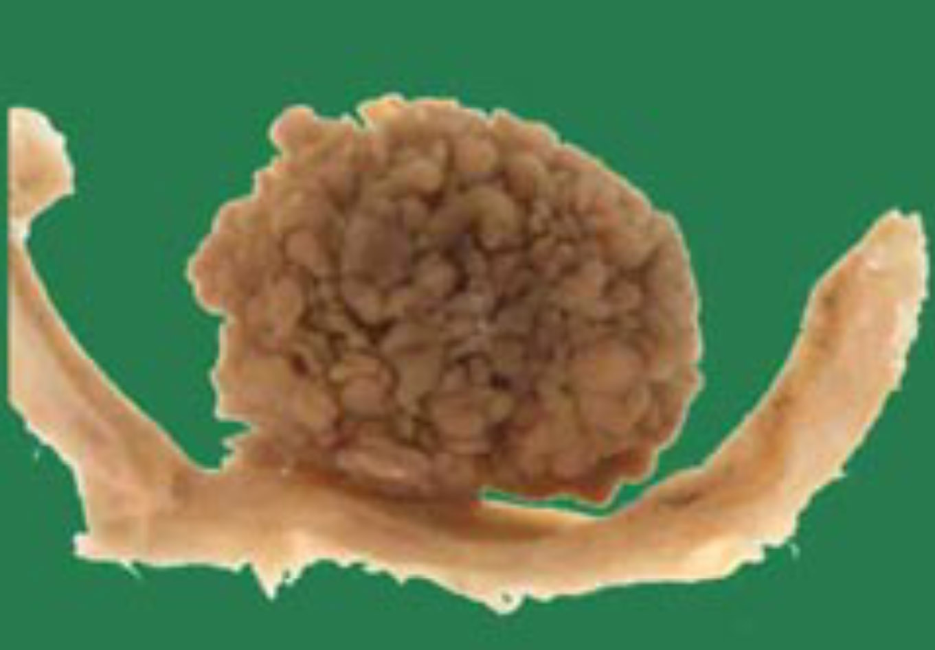
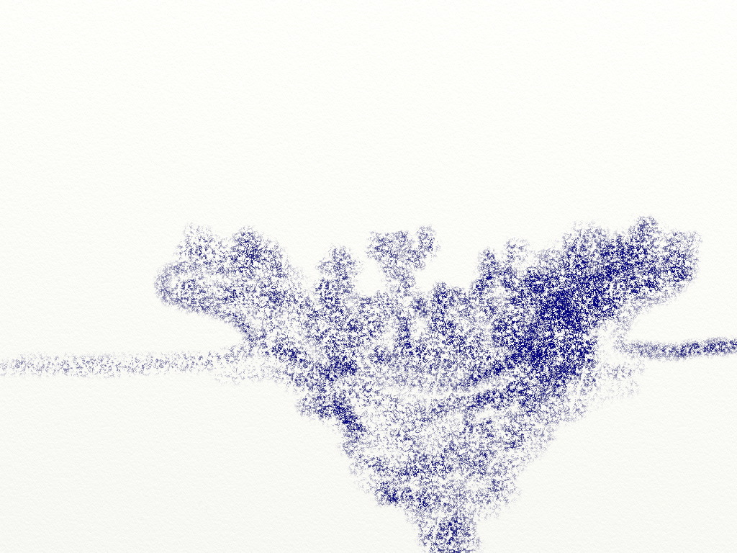
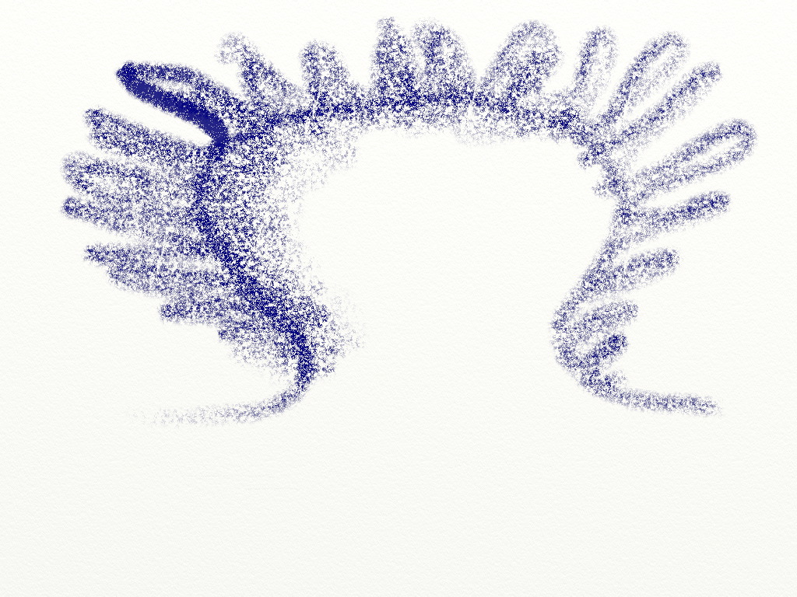
Cancer develops in multiple stages
Normal
Benign
Malignant
Notes:
Jones et al, 2008

Slide 23
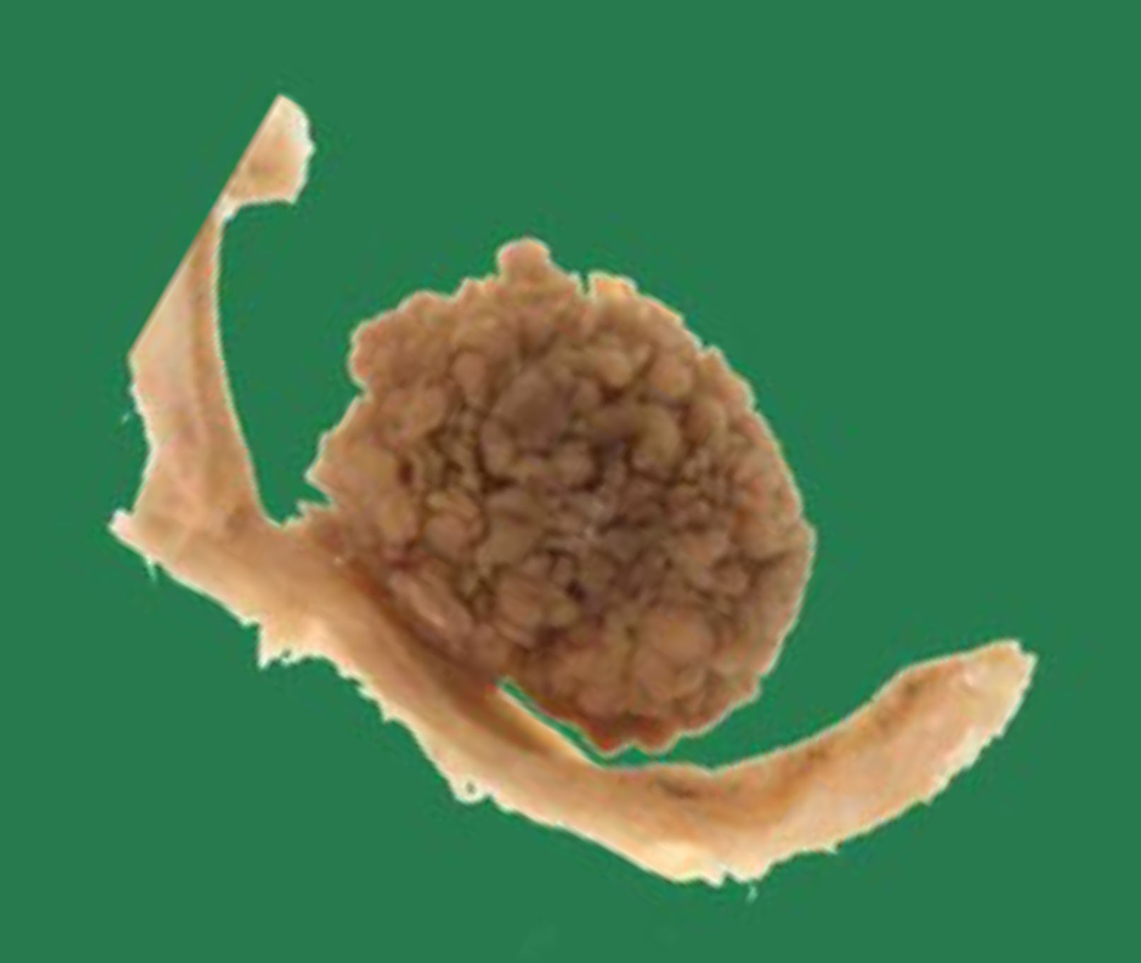
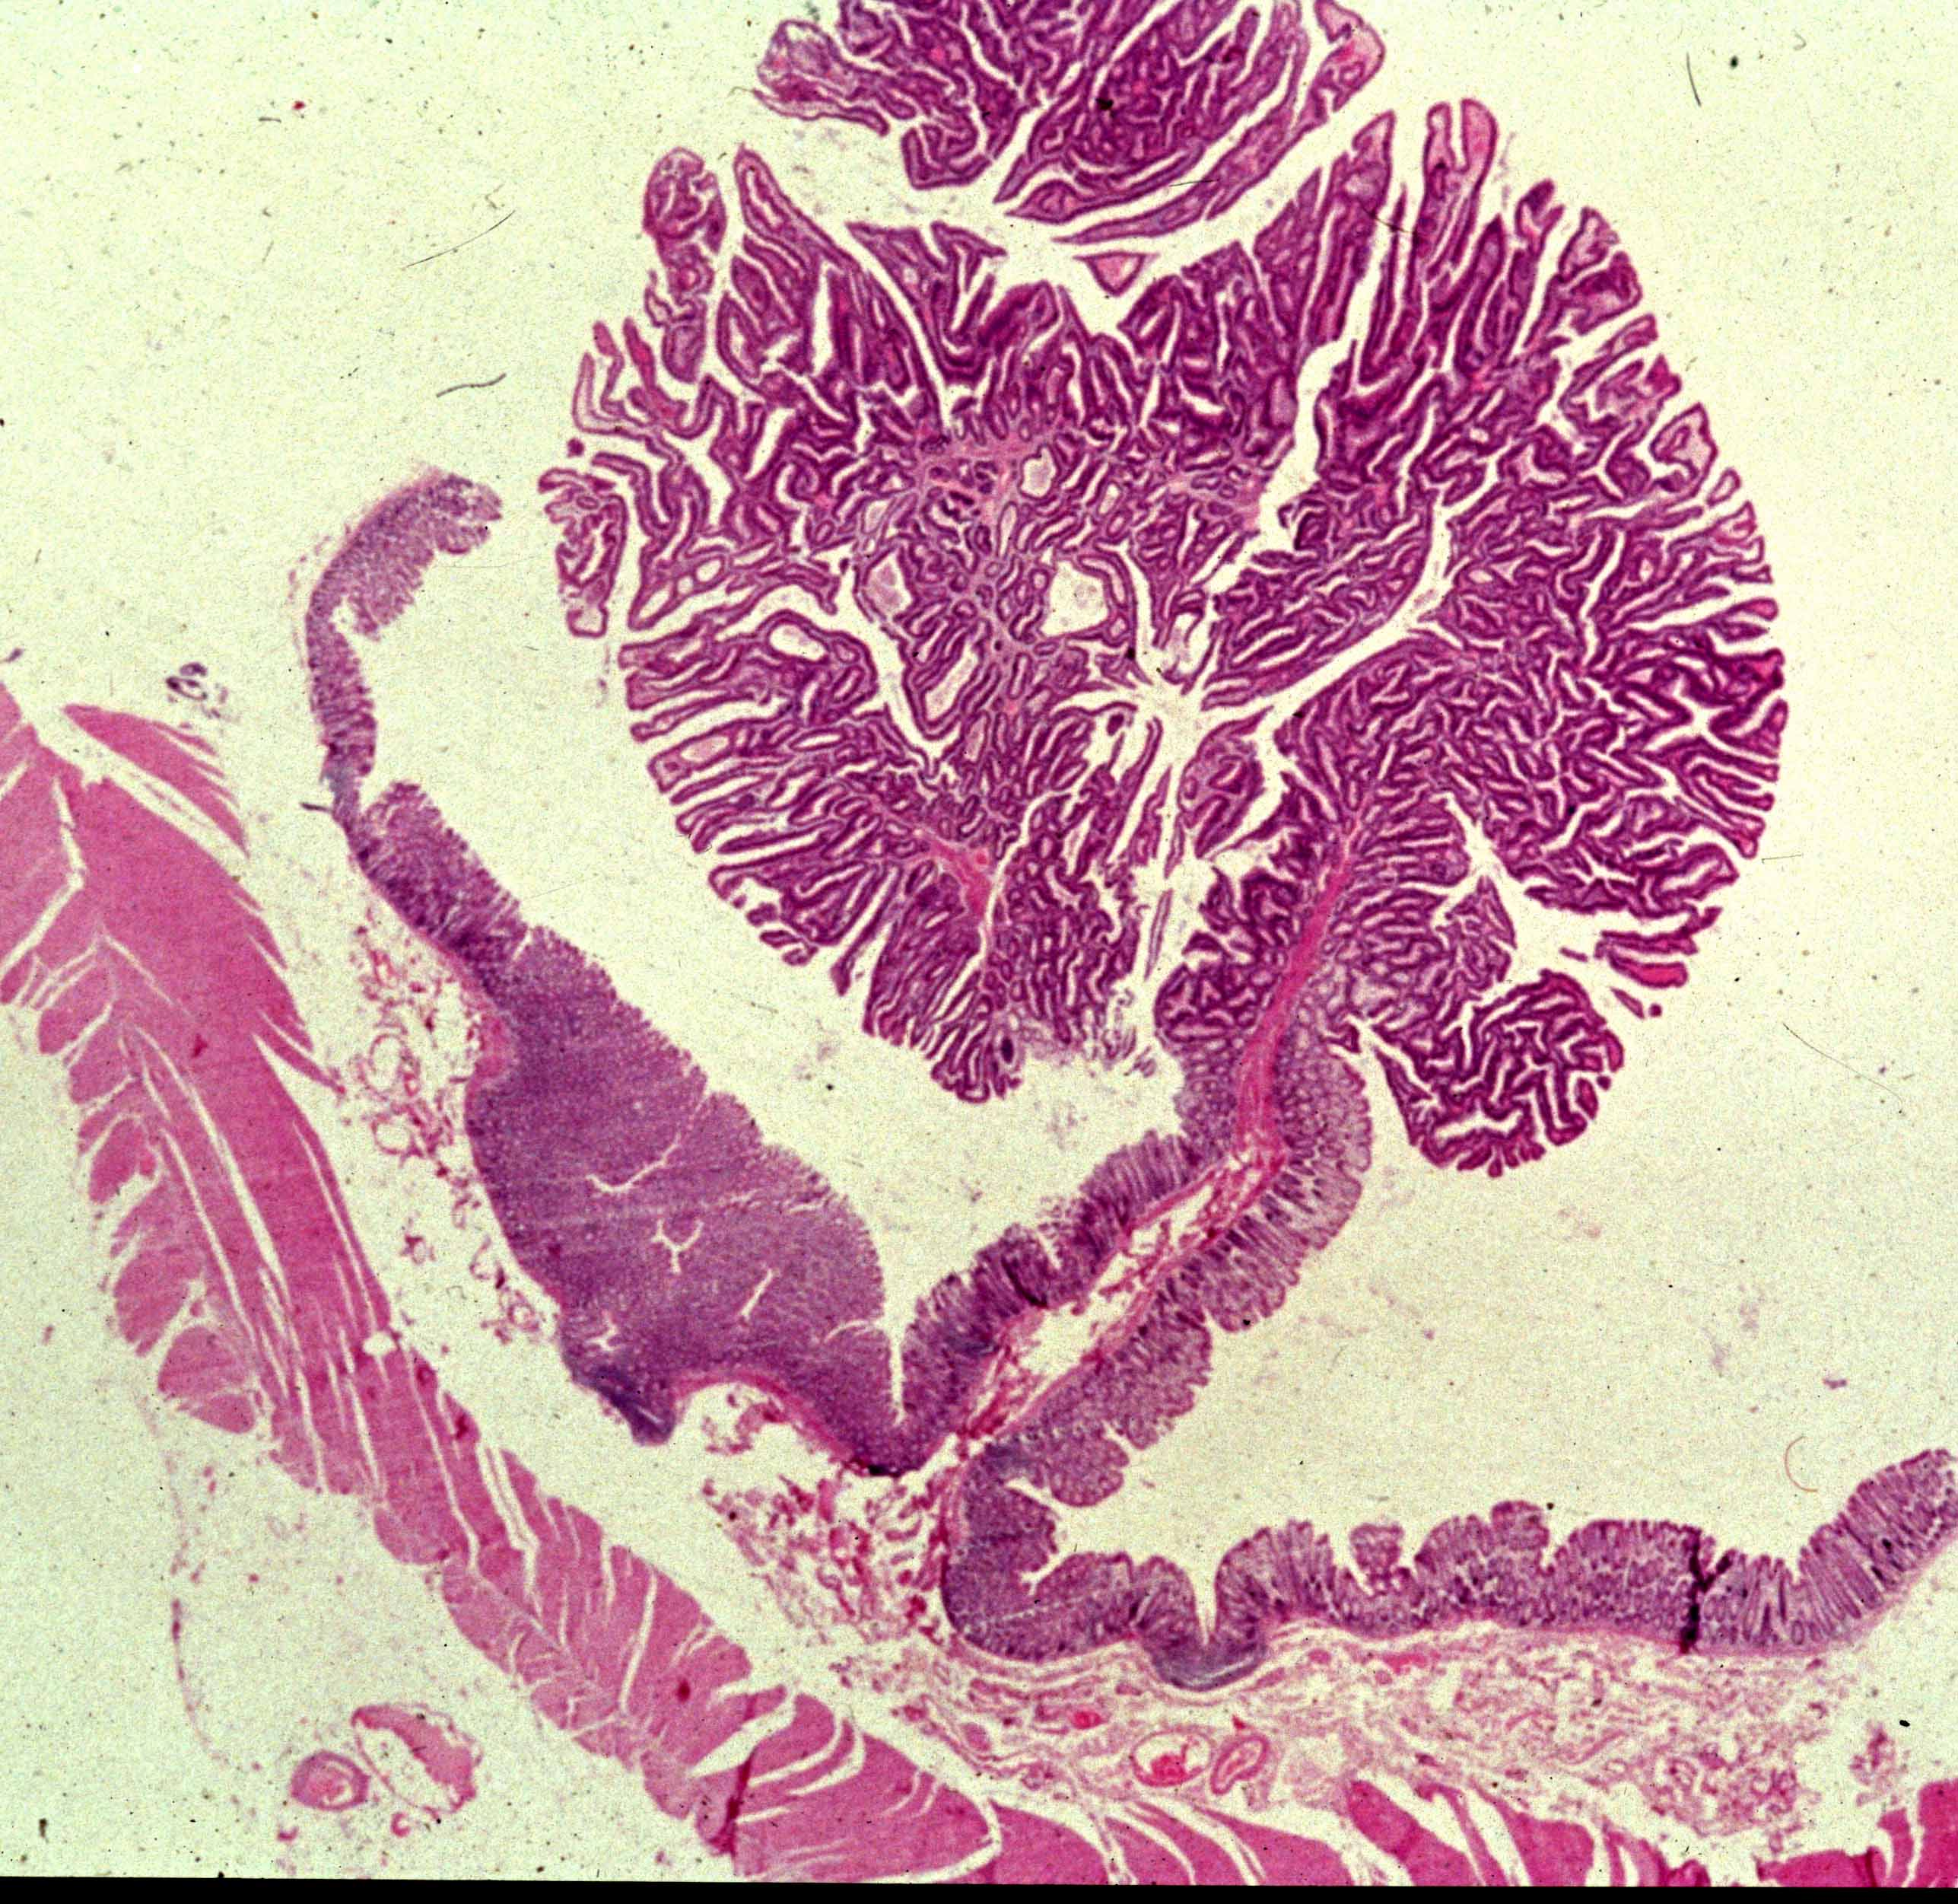
Colon cancer precursor: benign adenoma or polyp
Notes:
Jones et al, 2008

Slide 24
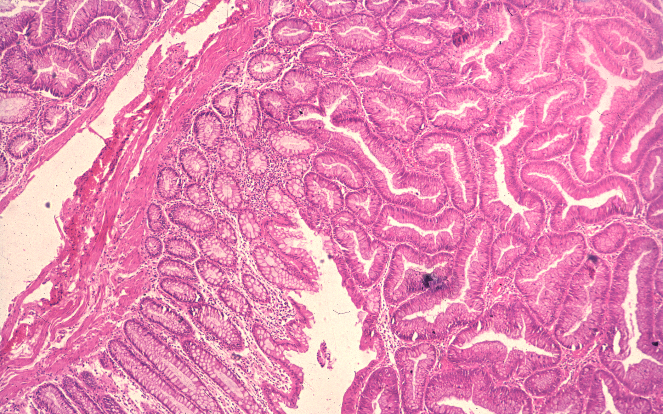

Slide 25
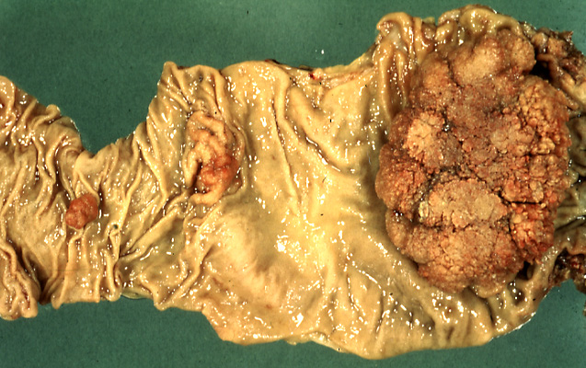
Colon/rectum cancer: malignant

Slide 26
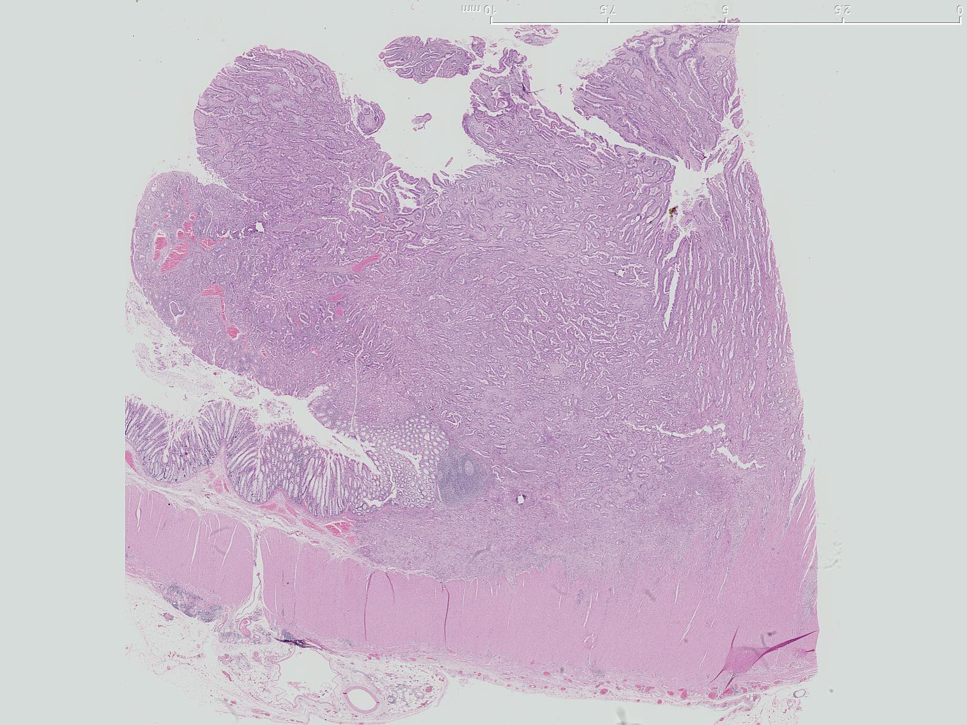
Colon cancer

Slide 27
Colon cancer
Cancer
Normal epithelium
Invasion
Normal Muscle

Slide 28
Colon cancer
Cancer
Normal epithelium
Invasion
Normal Muscle

Slide 29
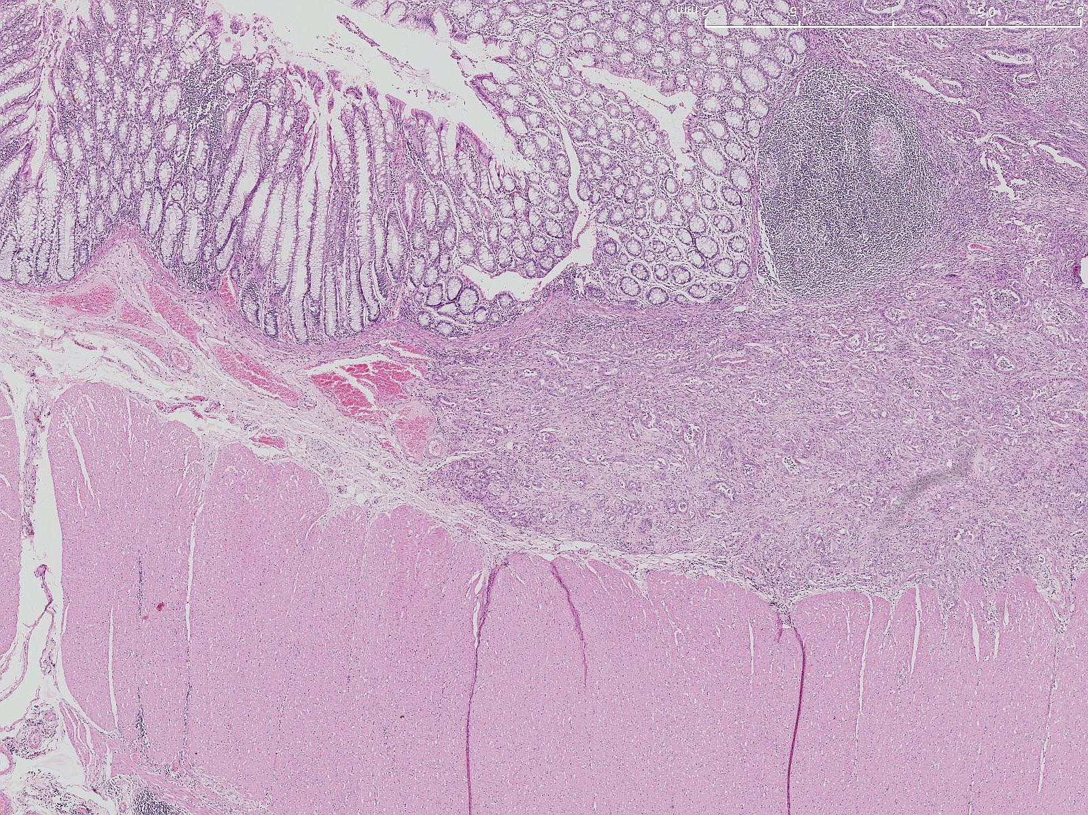
Colon cancer

Slide 30
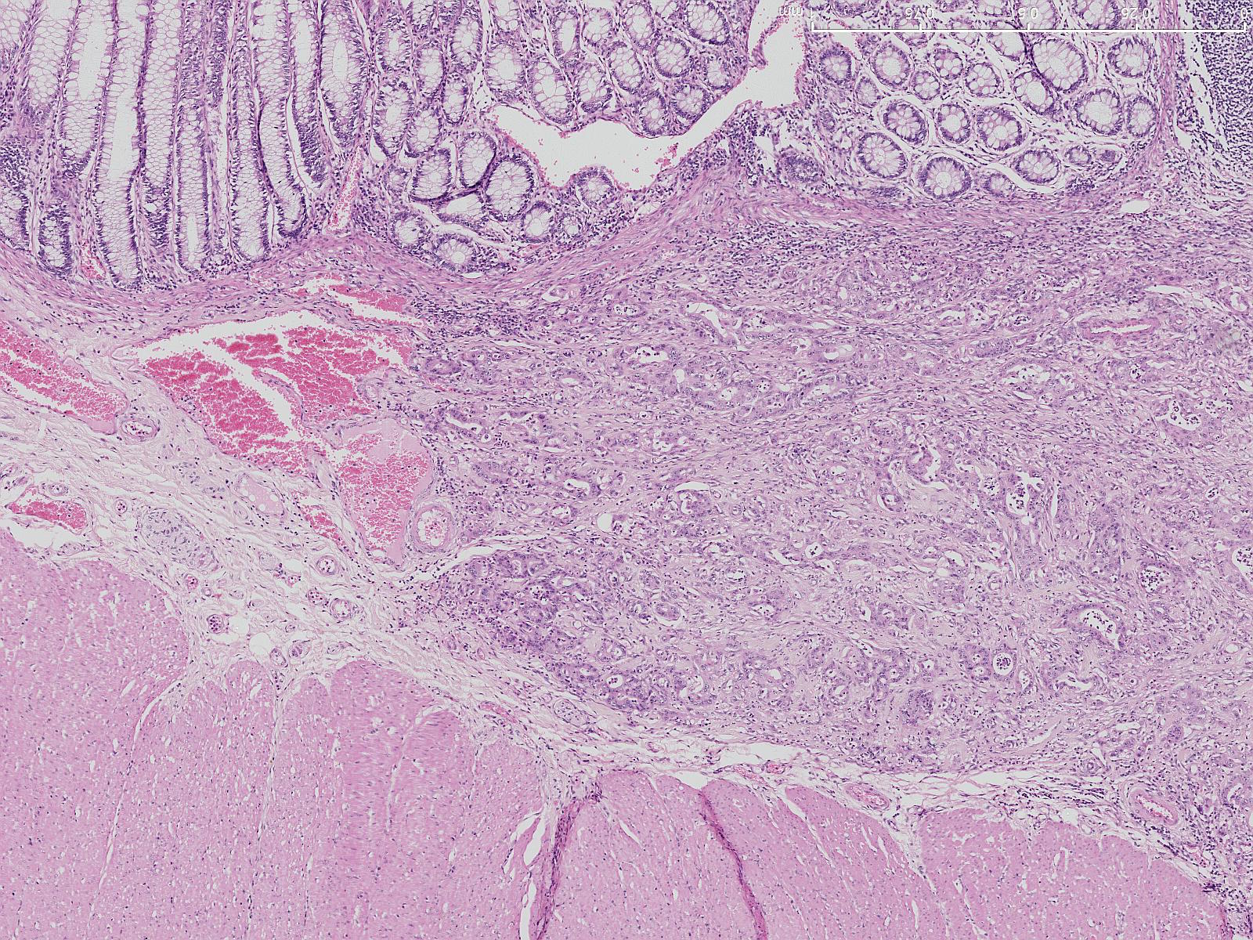
Colon cancer

Slide 31
Colon cancer
Cancer
Normal epithelium
Invasion
Normal Muscle

Slide 32
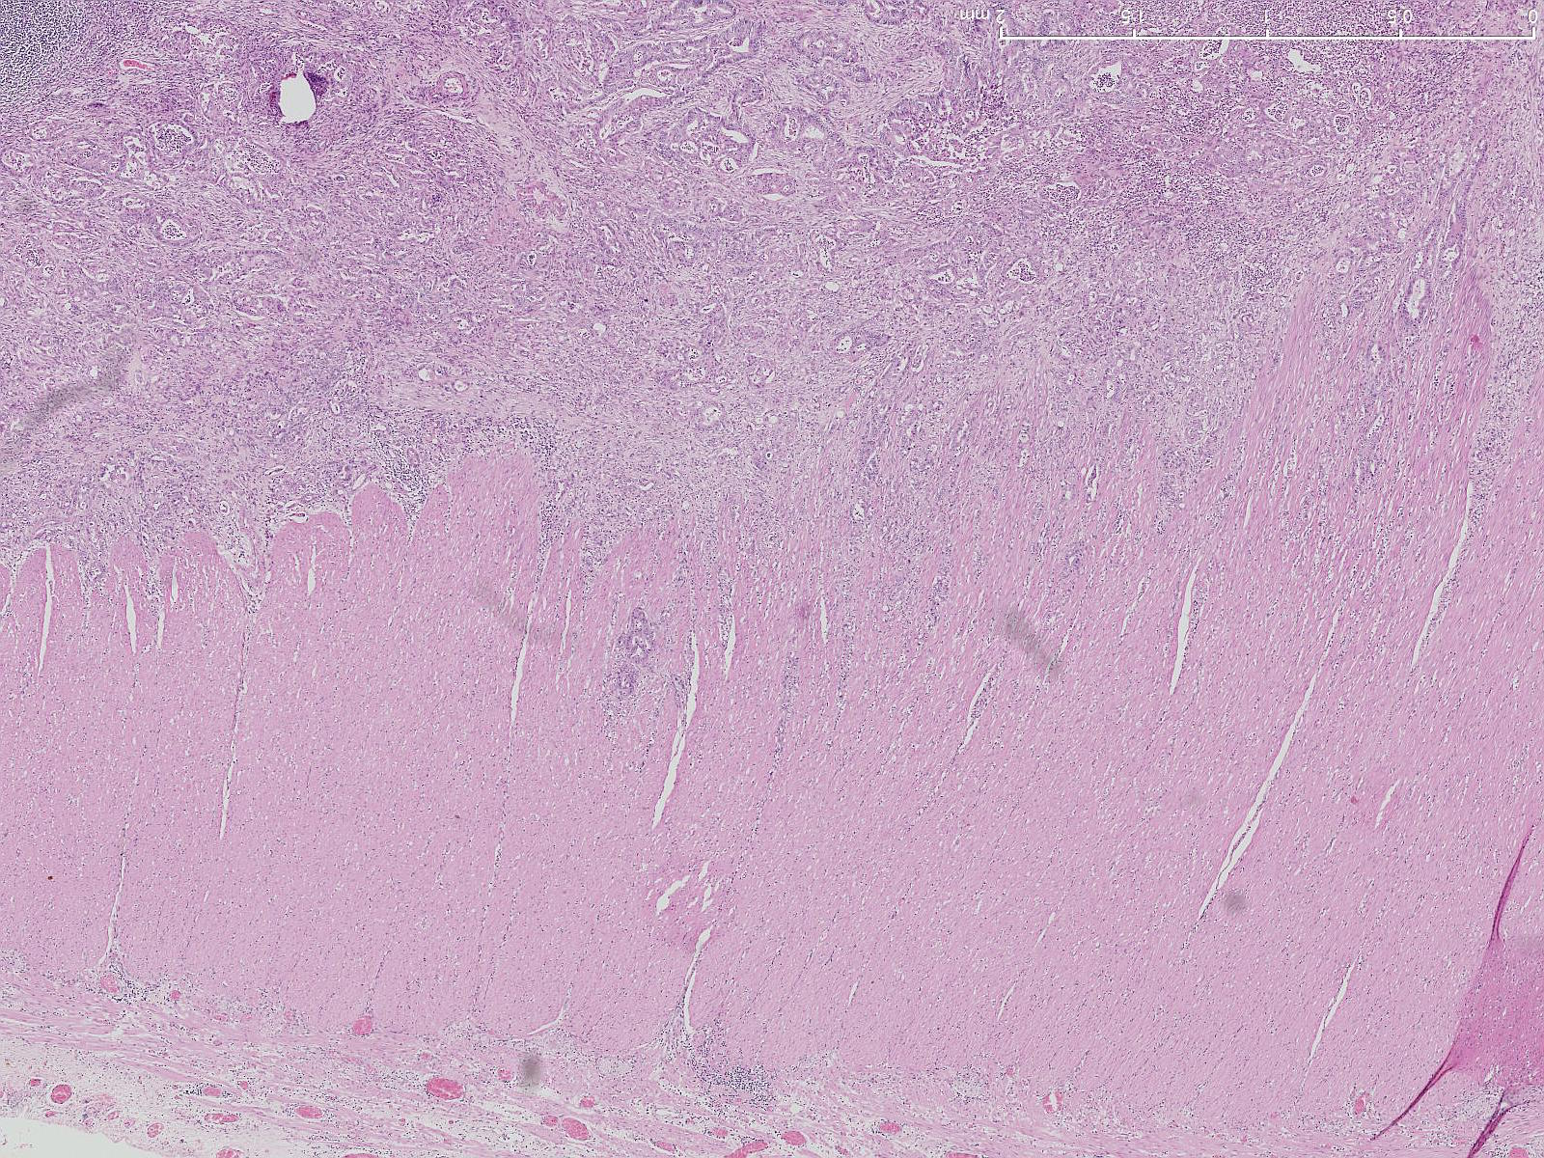
Colon cancer

Slide 33
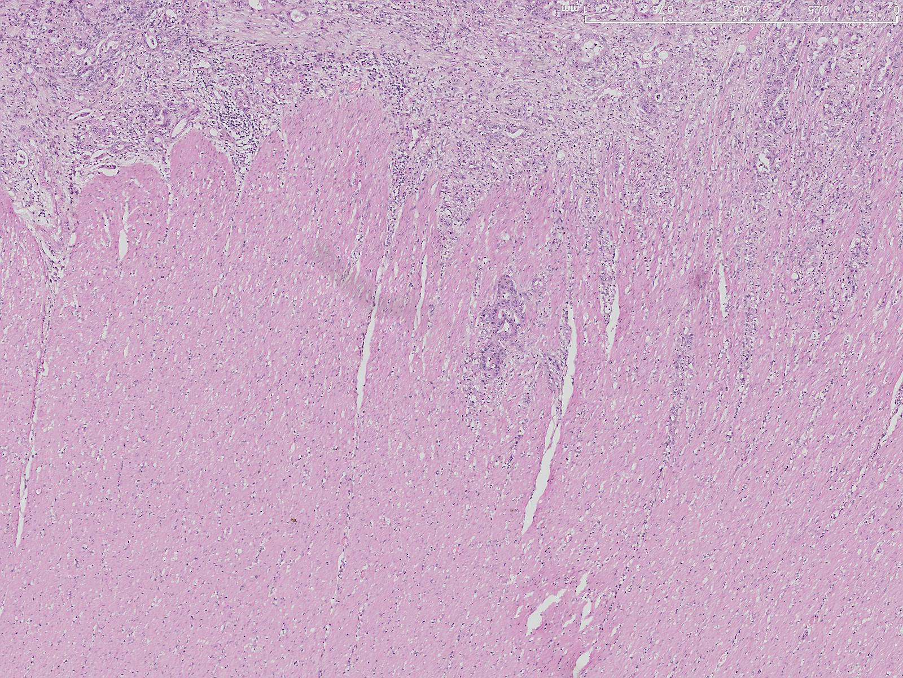
Colon cancer

Slide 34
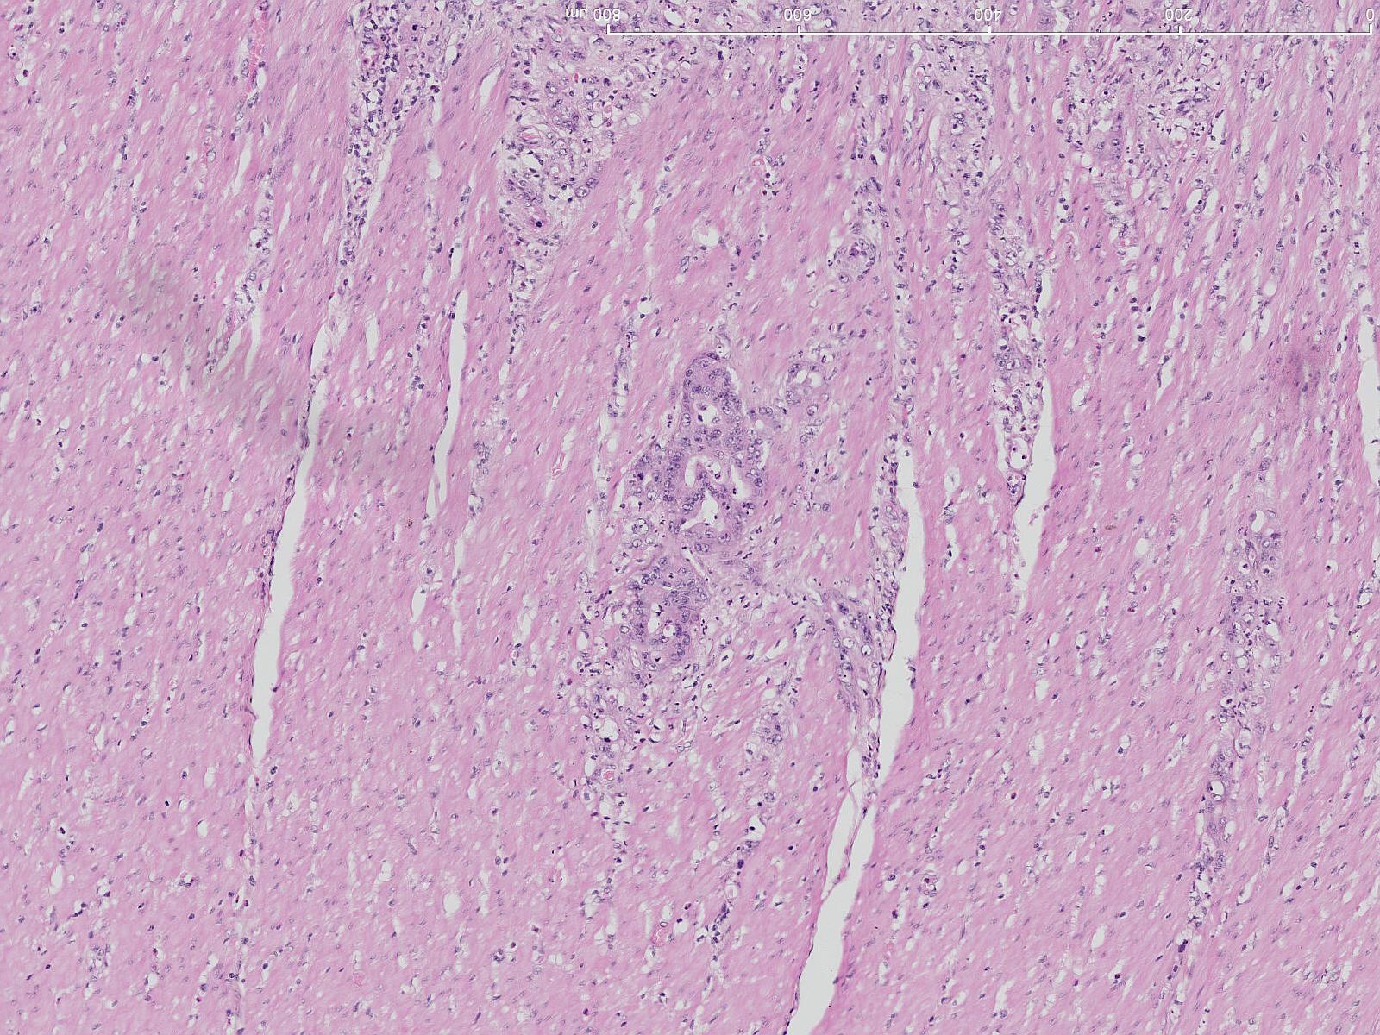
Colon cancer

Slide 35
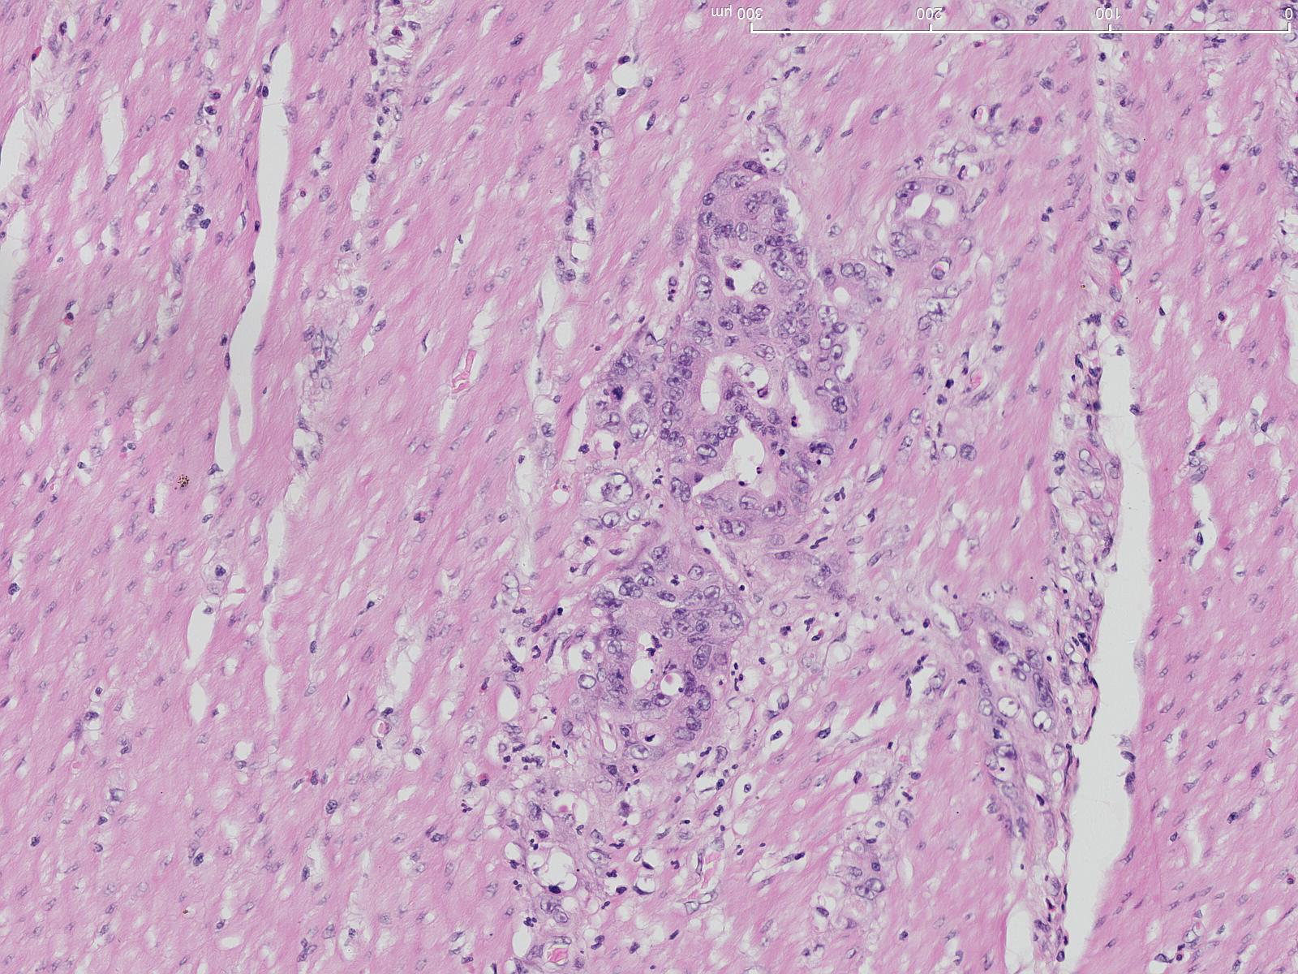
Malignant ‘invasion’: spread into muscle
Cancer
Normal Muscle

Slide 36
Normal muscle
With tumour

Slide 37
Vogelstein model of colon cancer
- a classic example of stages in cancer development
Benign
Malignant
Notes:
Jones et al, 2008

Slide 38
Cause of illness and death
Loss of function
e.g. failure of normal bone marrow in leukaemia
(see also spleen)
Liver overwhelmed by metastatic colon cancer
etc etc

Slide 39
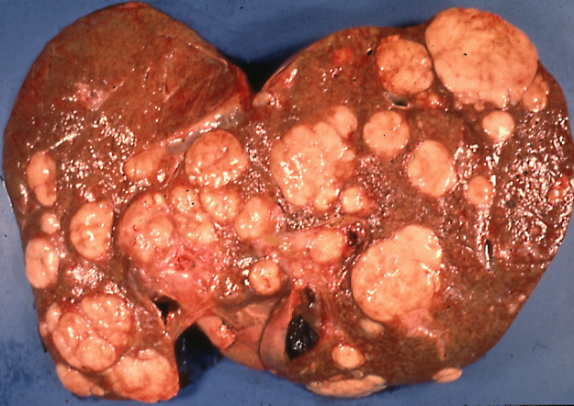
Multiple metastases in the liver
Notes:
S_NP_CA_LV_01 Hepatoma with multiple metastases including liver. Oesophageal ulceration with haemorrhage, over varices.

Slide 40
Presentation and screening

Slide 41
Colon/rectum cancer: pain, bleeding...

Slide 42
Best example of screening Cervical Cancer

Slide 43
Cervical Cancer: Second Classic multistep example
Illustrates:
multiple stages
Benign to malignant transition
Metaplasia
Virus infection
screening

Slide 44
Cervix and cervical Cancer
uterus
Columnar
epithelium
*
*
Squamous epithelium
vagina

Slide 45
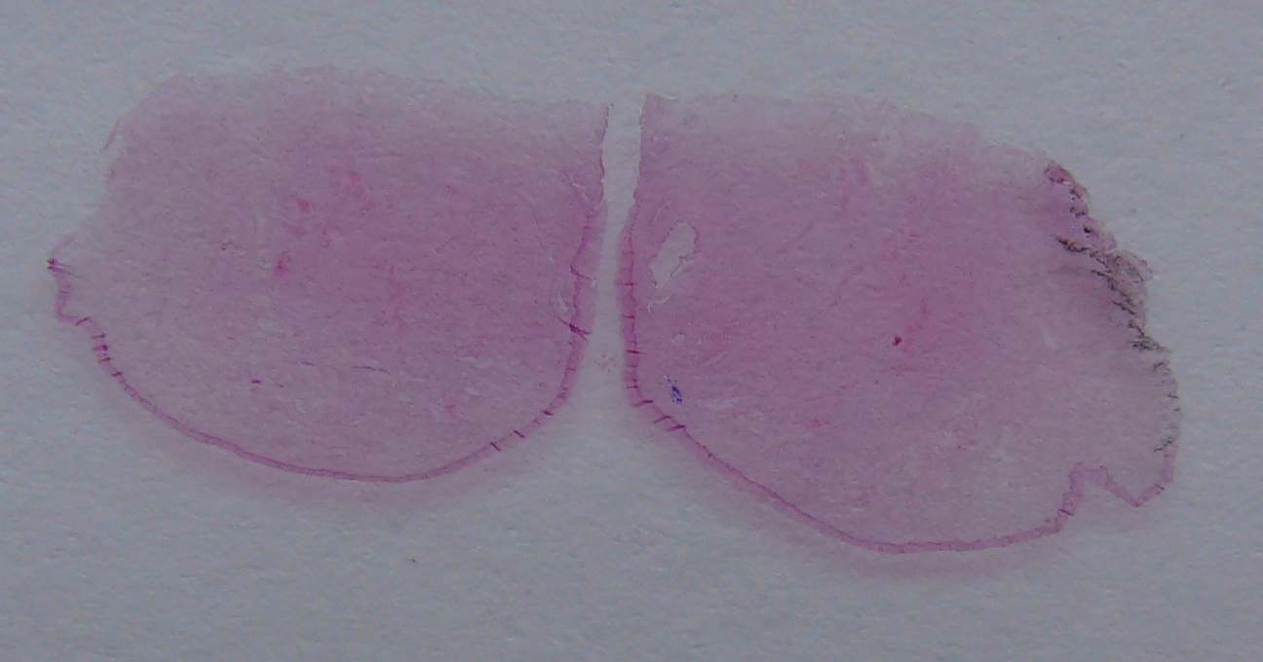
Cervix at low power
uterus, glandular
vagina, squamous

Slide 46
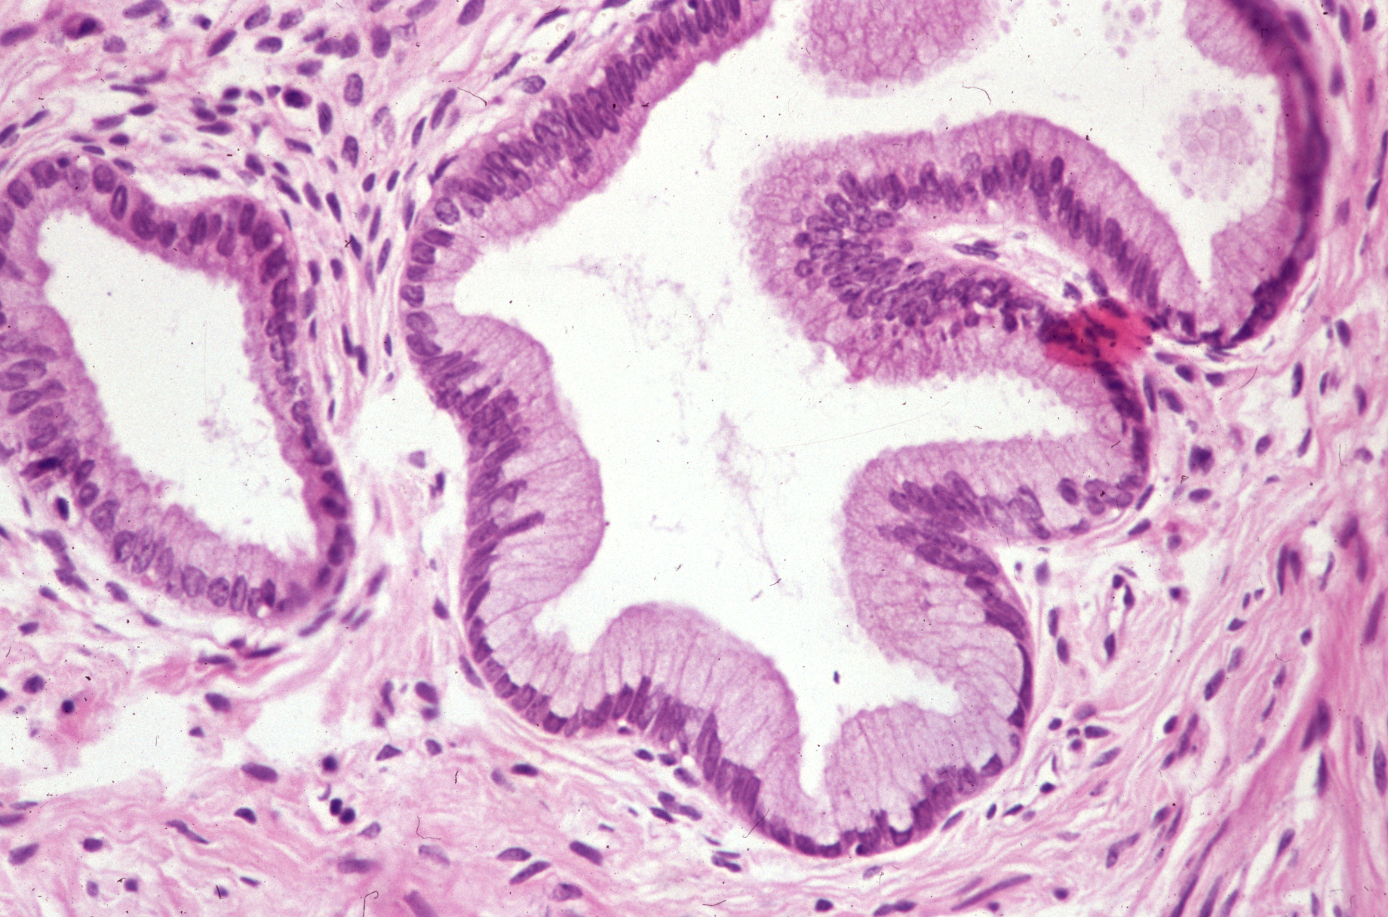
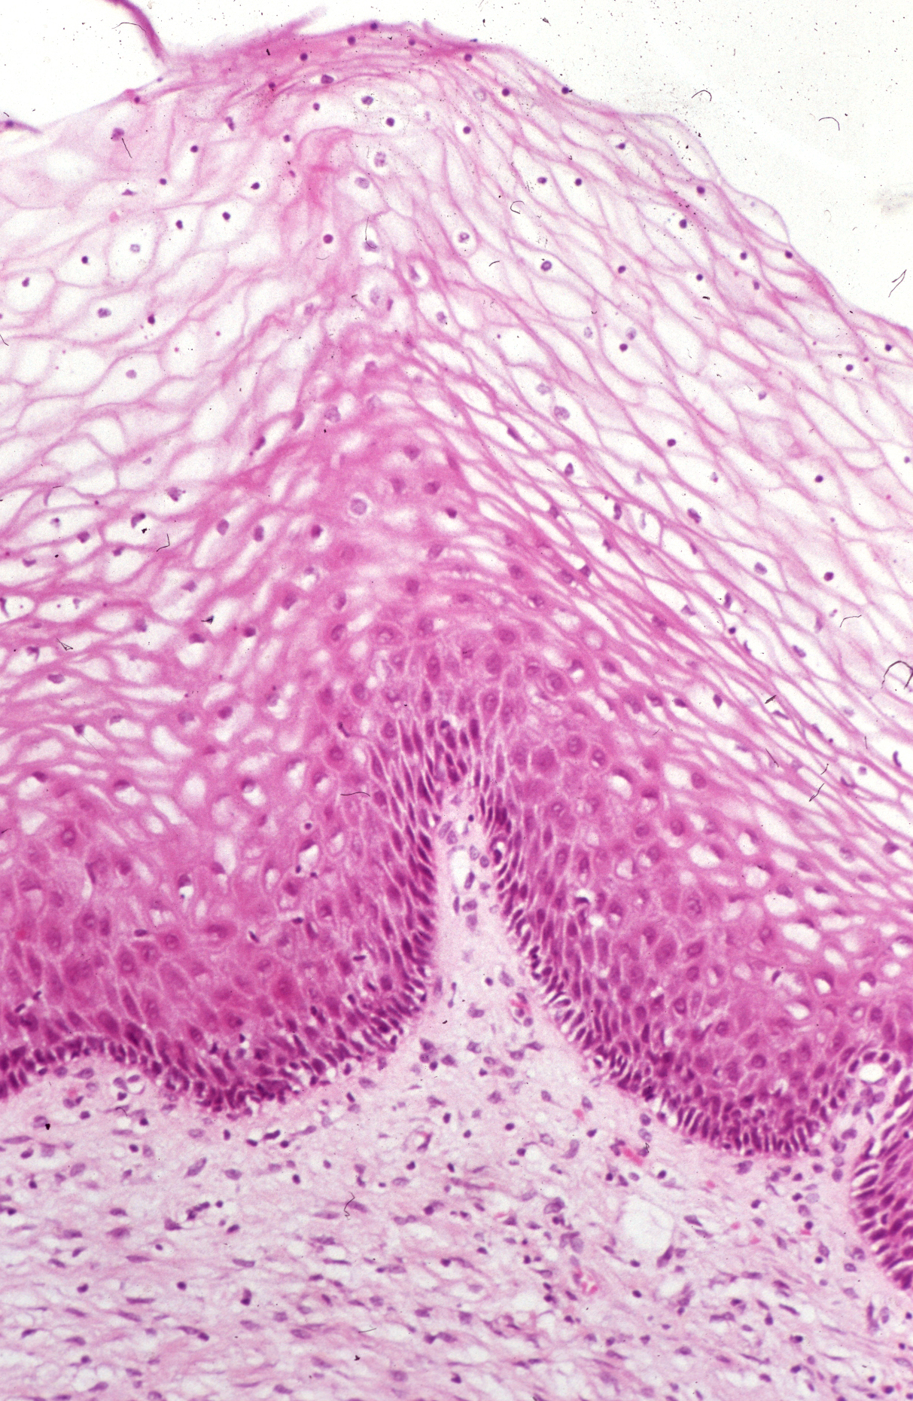
Cervix at low power
glandular
*
*
squamous

Slide 47
Cervix and cervical Cancer
uterus
Columnar
epithelium
*
*
Squamous epithelium
Virus infection (HPV)

Slide 48
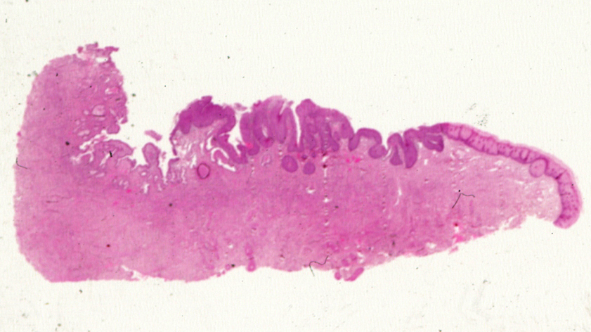
Very dysplastic but still benign cervix epithelium ‘CINIII’
uterus, glandular
vagina, squamous
Notes:
Metaplasia and dysplasia leading to an advanced but still not malignant lesion, confined to the epithelial surface

Slide 49
Very dysplastic but still benign cervix epithelium ‘CINIII’
normal glandular
squamous metaplasia
+
severe dysplasia
‘CINIII’
normal squamous
Notes:
Metaplasia and dysplasia leading to an advanced but still not malignant lesion, confined to the epithelial surface

Slide 50
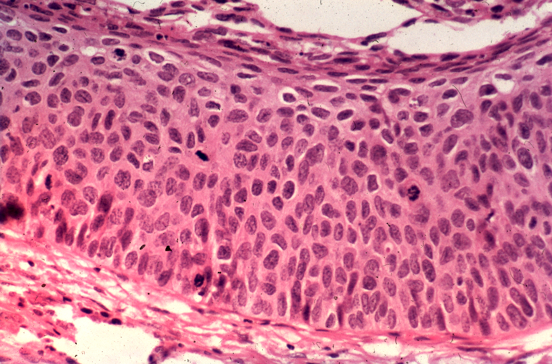
Very dysplastic but still benign cervix epithelium ‘CINIII’
normal glandular
squamous metaplasia
+
severe dysplasia
‘CINIII’
normal squamous
Notes:
Metaplasia and dysplasia leading to an advanced but still not malignant lesion, confined to the epithelial surface

Slide 51
Very dysplastic but still benign cervix epithelium ‘CINIII’
normal glandular
squamous metaplasia
+
severe dysplasia
‘CINIII’
normal squamous
Notes:
Metaplasia and dysplasia leading to an advanced but still not malignant lesion, confined to the epithelial surface

Slide 52
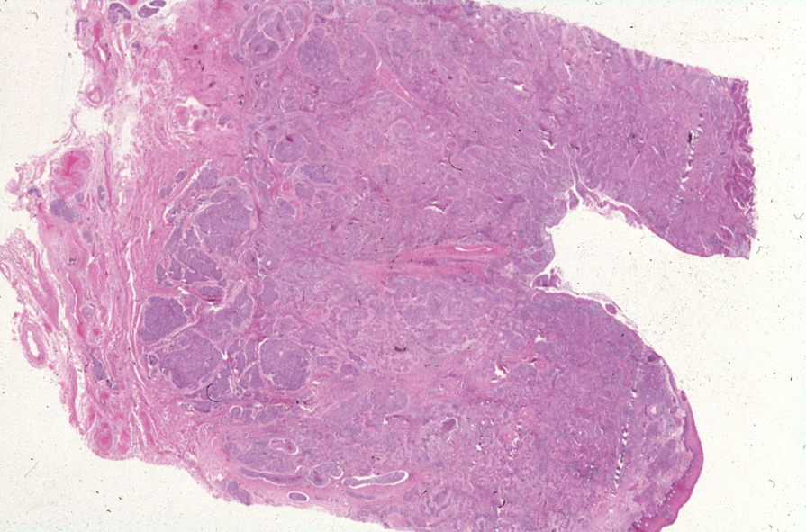
Malignant - Carcinoma

Slide 53
Cervix and cervical Cancer
uterus
Columnar
epithelium
*
*
Squamous metaplasia
and Virus infection (HPV):
Pre-Invasive
Squamous epithelium

Slide 54
Precursor - detect by screening
Notes:
54

Slide 55
Screening: cervix is ideal
uterus
pre-invasive
vagina
Scrape sample
Notes:
Concept of presentation and its relationship to screening

Slide 56
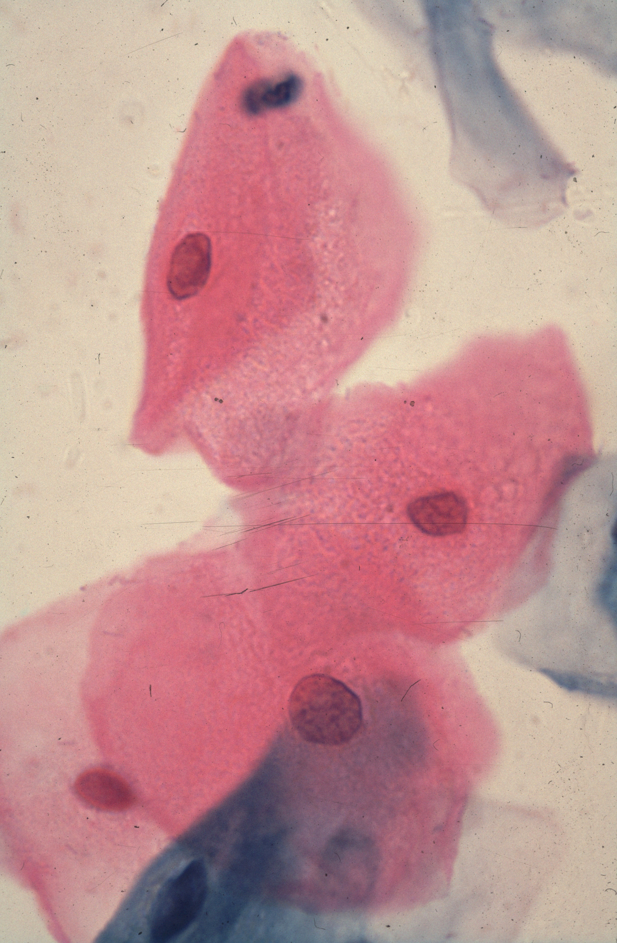
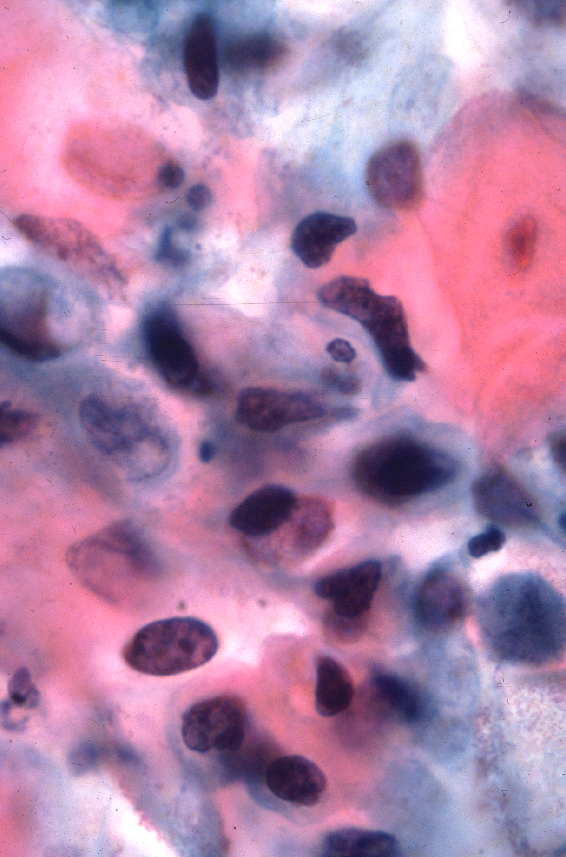
Cervical smears
abnormal:
large pleomorphic nuclei
- normal

Slide 57
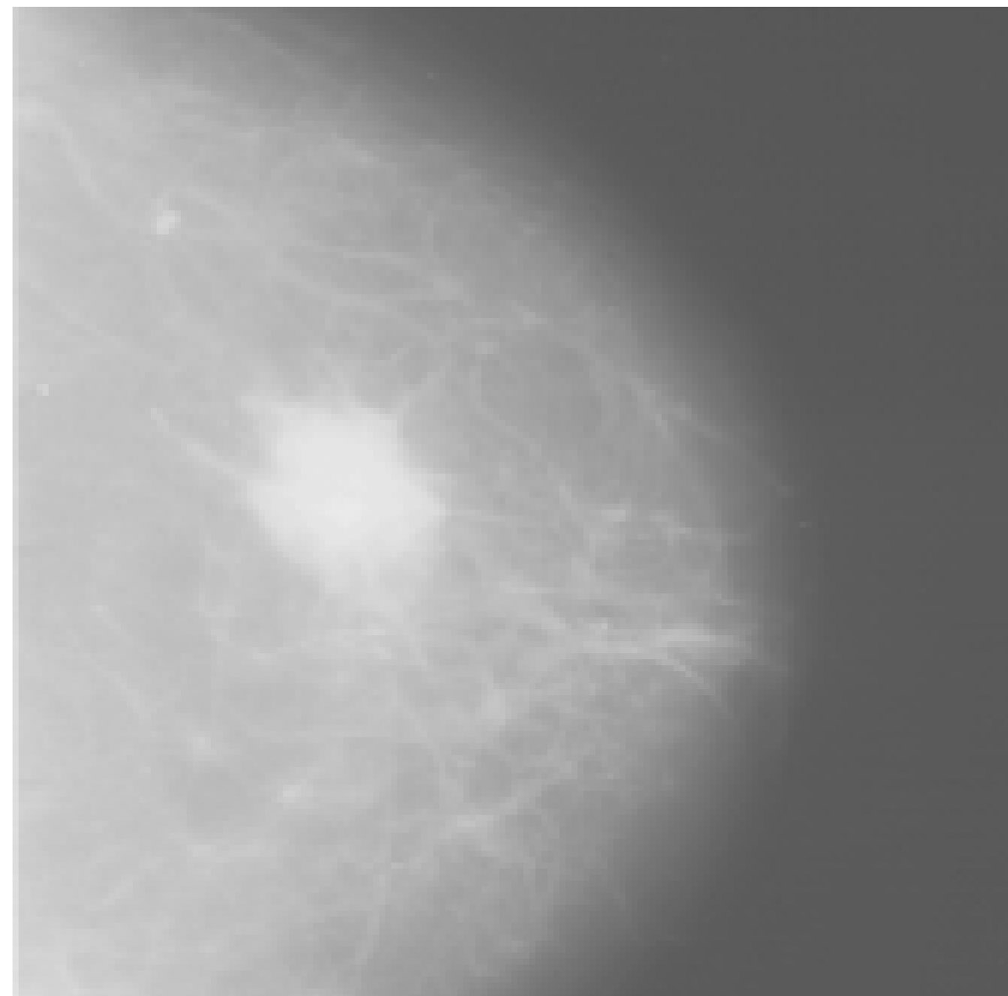
Screening: breast

Slide 58
Miscell
Hereditary predisposition - polyposis (vs HNPCC)
Benign Teratoma
(Meningioma)
Basal cell carcinoma

Slide 59
hereditary predisposition
NOT QUITE
Slightly
Abnormal
More
Abnormal
Normal
Cell
Malignant
•
•
Gene changes / mutations

Slide 60
Vogelstein model of colon cancer
- a classic example of stages in cancer development
Benign
Malignant
Notes:
Put in to explain polyposis pot

